Slide 1
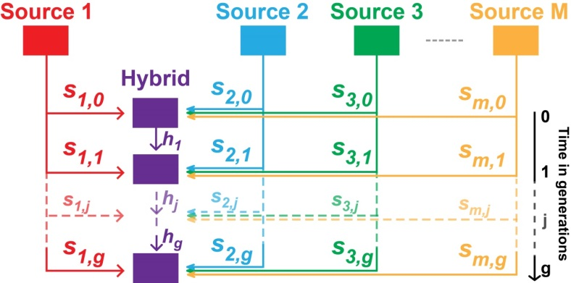



Complex genetic admixture histories reconstructed with Approximate Bayesian Computation
Paul Verdu
Lab: UMR7206 Eco-anthropologie
Institution: CNRS – MnHn - Université de Paris
Rosenberg Lab, Stanford University
February 2021

Slide 2
Admixture is ubiquitous in evolutionary history,
through time and space
e.g. Homo sapiens
Skoglund et al., Science 2012
Quach and Quintana-Murci, JEM 2017
e.g. Nielsen et al., Nature 2018
Patin et al., Science 2017

Slide 3
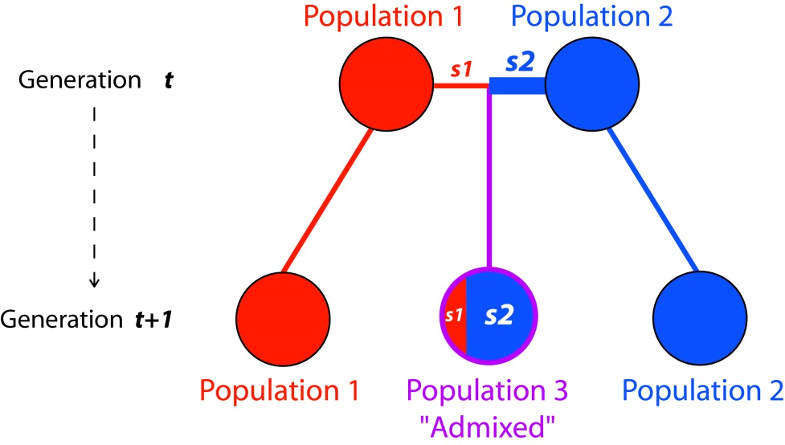
Defining Admixture
Exchanges of genes between two or more previously reproductively isolated populations
s₁ + s₂ = 1
Admixed individuals have a fraction of their genome coming from each source population
Individuals in the “admixed population” are not necessarily all genetically admixed

Slide 4
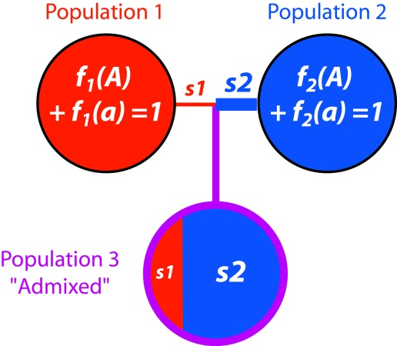
Estimating admixture from genetic data
Allele frequencies in an admixed population can be considered as a linear combination of allele frequencies in the parental populations (e.g. Bernstein 1931)
s₁ + s₂ = 1

Slide 5
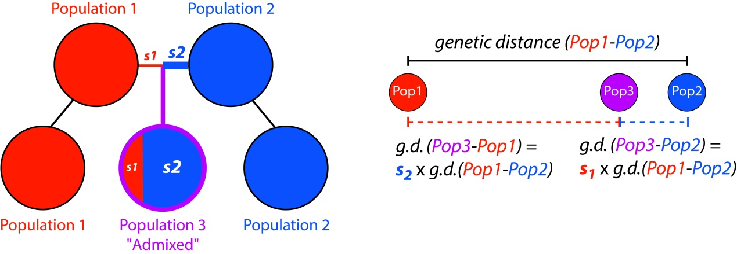
Estimating admixture from genetic data
Allele frequencies in an admixed population can be considered as a linear combination of allele frequencies in the parental populations (e.g. Bernstein 1931)
s₁ + s₂ = 1
s₁ + s₂ = 1
Numerous statistical approaches to detect and infer genetic admixture in a variety of plant and animal species have been developed
(e.g. Long, Genetics 1991; Bertorelle and Excoffier, Mol Biol Evol 2003; Falush et al., Genetics 2003; Alexander et al., Gen Res 2009; Patterson et al., Genetics 2012)

Slide 6
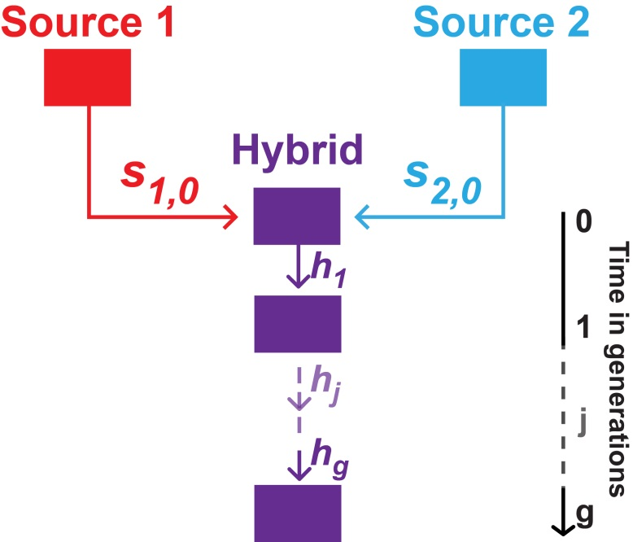
Inferring admixture history from genetic data

Slide 7
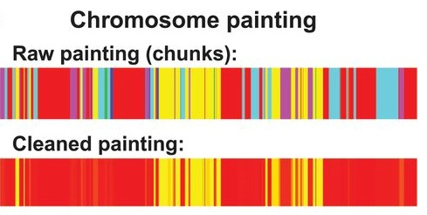
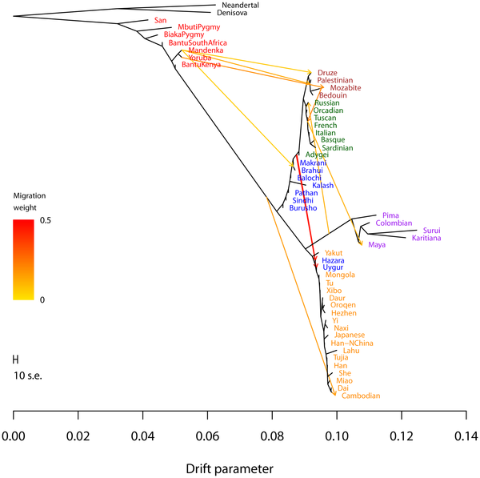
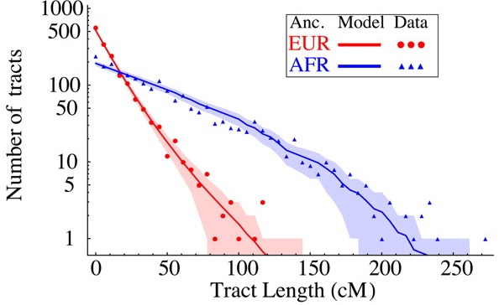
Inferring admixture history from genetic data
Hellenthal et al., Nature 2014
Maximum likelihood approaches relying on:
► Admixture Linkage-Disequilibrium distributions - e.g. TRACTS (Gravel 2012), GLOBETROTTER (Hellenthal et al. 2014)
► Moments of allelic frequency spectrum divergences - e.g. M/ALDER (Loh et al. 2013), TreeMix (Pritchard et al. 2012)
Gravel, Genetics 2012
Pritchard et al., Plos Gen 2012

Slide 8
Inferring admixture history from genetic data
Hellenthal et al., Nature 2014
Maximum likelihood approaches relying on:
► Admixture Linkage-Disequilibrium distributions - e.g. TRACTS (Gravel 2012), GLOBETROTTER (Hellenthal et al. 2014)
► Moments of allelic frequency spectrum divergences - e.g. M/ALDER (Loh et al. 2013), TreeMix (Pritchard et al. 2012)
Gravel, Genetics 2012
Pritchard et al., Plos Gen 2012
Limited by:
► “Simple” admixture models: one or two admixture pulses per source population
► No formal model-choice
► Massive genomic data and accurate phasing for admixture-LD methods

Slide 9
Inferring admixture history from genetic data
ML-inference methods cannot operate
$$L\left(ModelParams | {Data}_{obs}\right)∝P\left({Data}_{obs} | ModelParams\right) P\left(ModelParams\right)$$
for highly complex admixture models where likelihoods cannot be written
for highly complex admixture models where likelihoods are intractable

Slide 10

Inferring admixture history from genetic data
ML-inference methods cannot operate
$$L\left(ModelParams | {Data}_{obs}\right)∝P\left({Data}_{obs} | ModelParams\right) P\left(ModelParams\right)$$
for highly complex admixture models where likelihoods cannot be written
for highly complex admixture models where likelihoods are intractable
Approximate Bayesian Computation (Tavaré et al. 1997) may represent an alternative
$$L\left(ModelParams | {Data}_{obs}\right)∝P\left({Data}_{obs} | ModelParams\right) P\left(ModelParams\right)$$
$$≈$$
Approximation
$$L\left(ModelParams | {SumStat}_{obs}\right)∝P\left({SumStat}_{obs} | ModelParams\right) P\left(ModelParams\right)$$

Slide 11
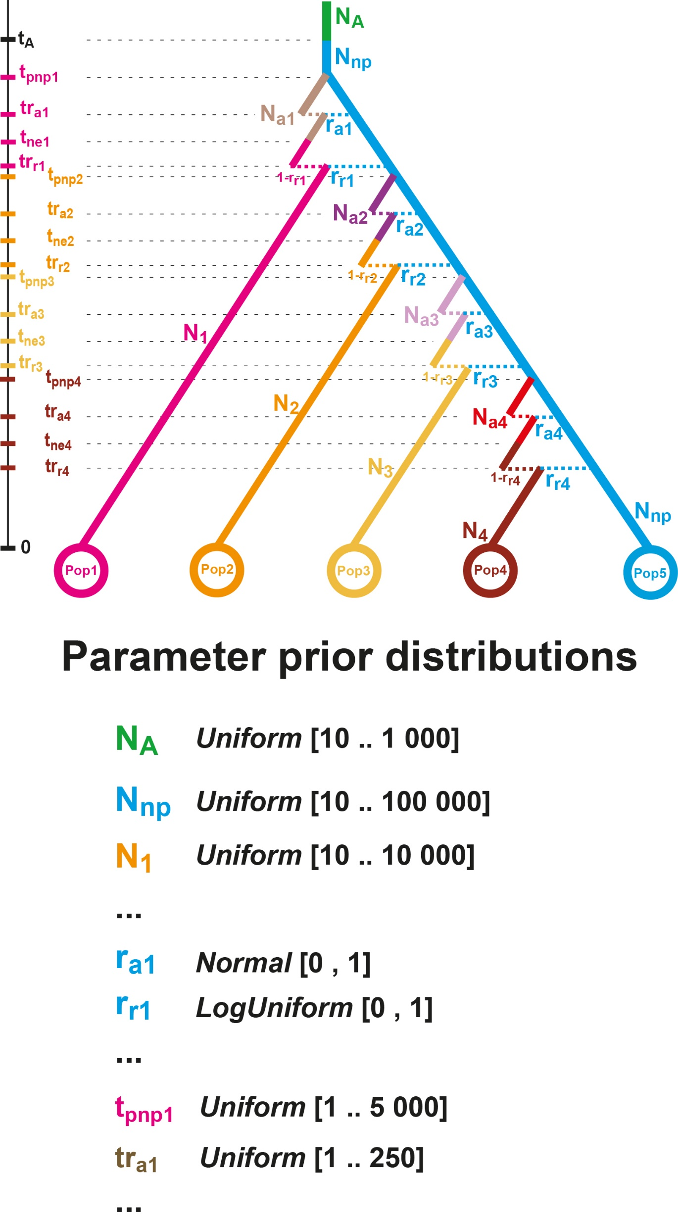
Approximate Bayesian Computation demographic inference
Tavaré et al., Plos Gen 1997
Pritchard et al., Genetics 2000
Beaumont et al., Genetics 2002

Slide 12
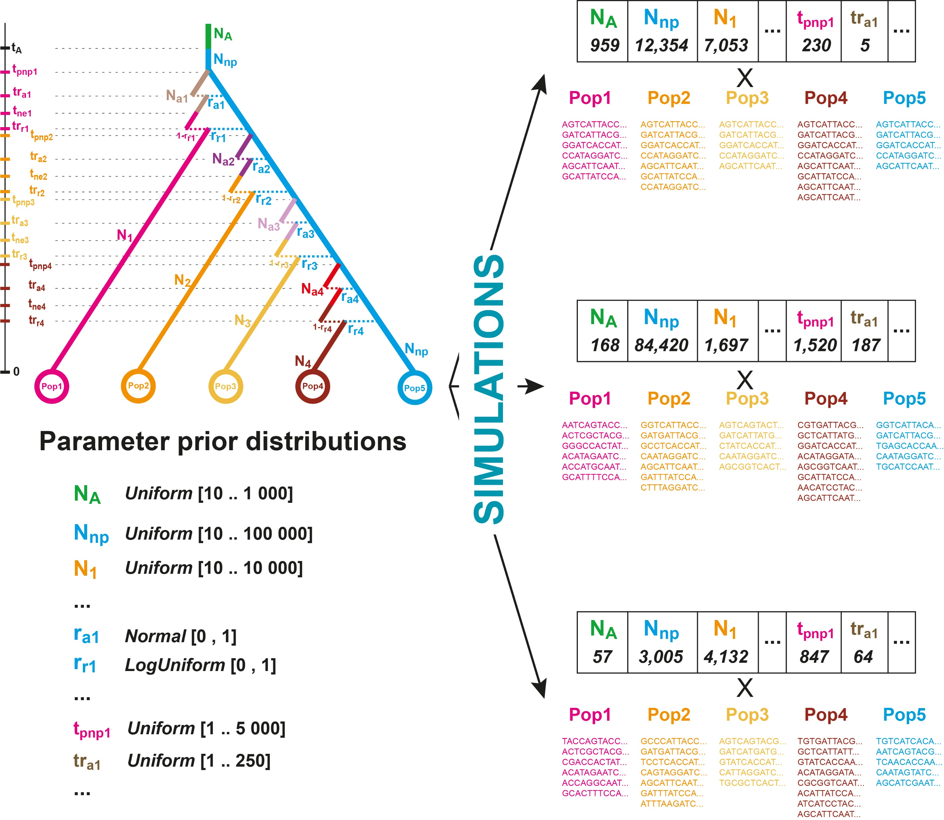
Approximate Bayesian Computation demographic inference
Tavaré et al., Plos Gen 1997
Pritchard et al., Genetics 2000
Beaumont et al., Genetics 2002

Slide 13
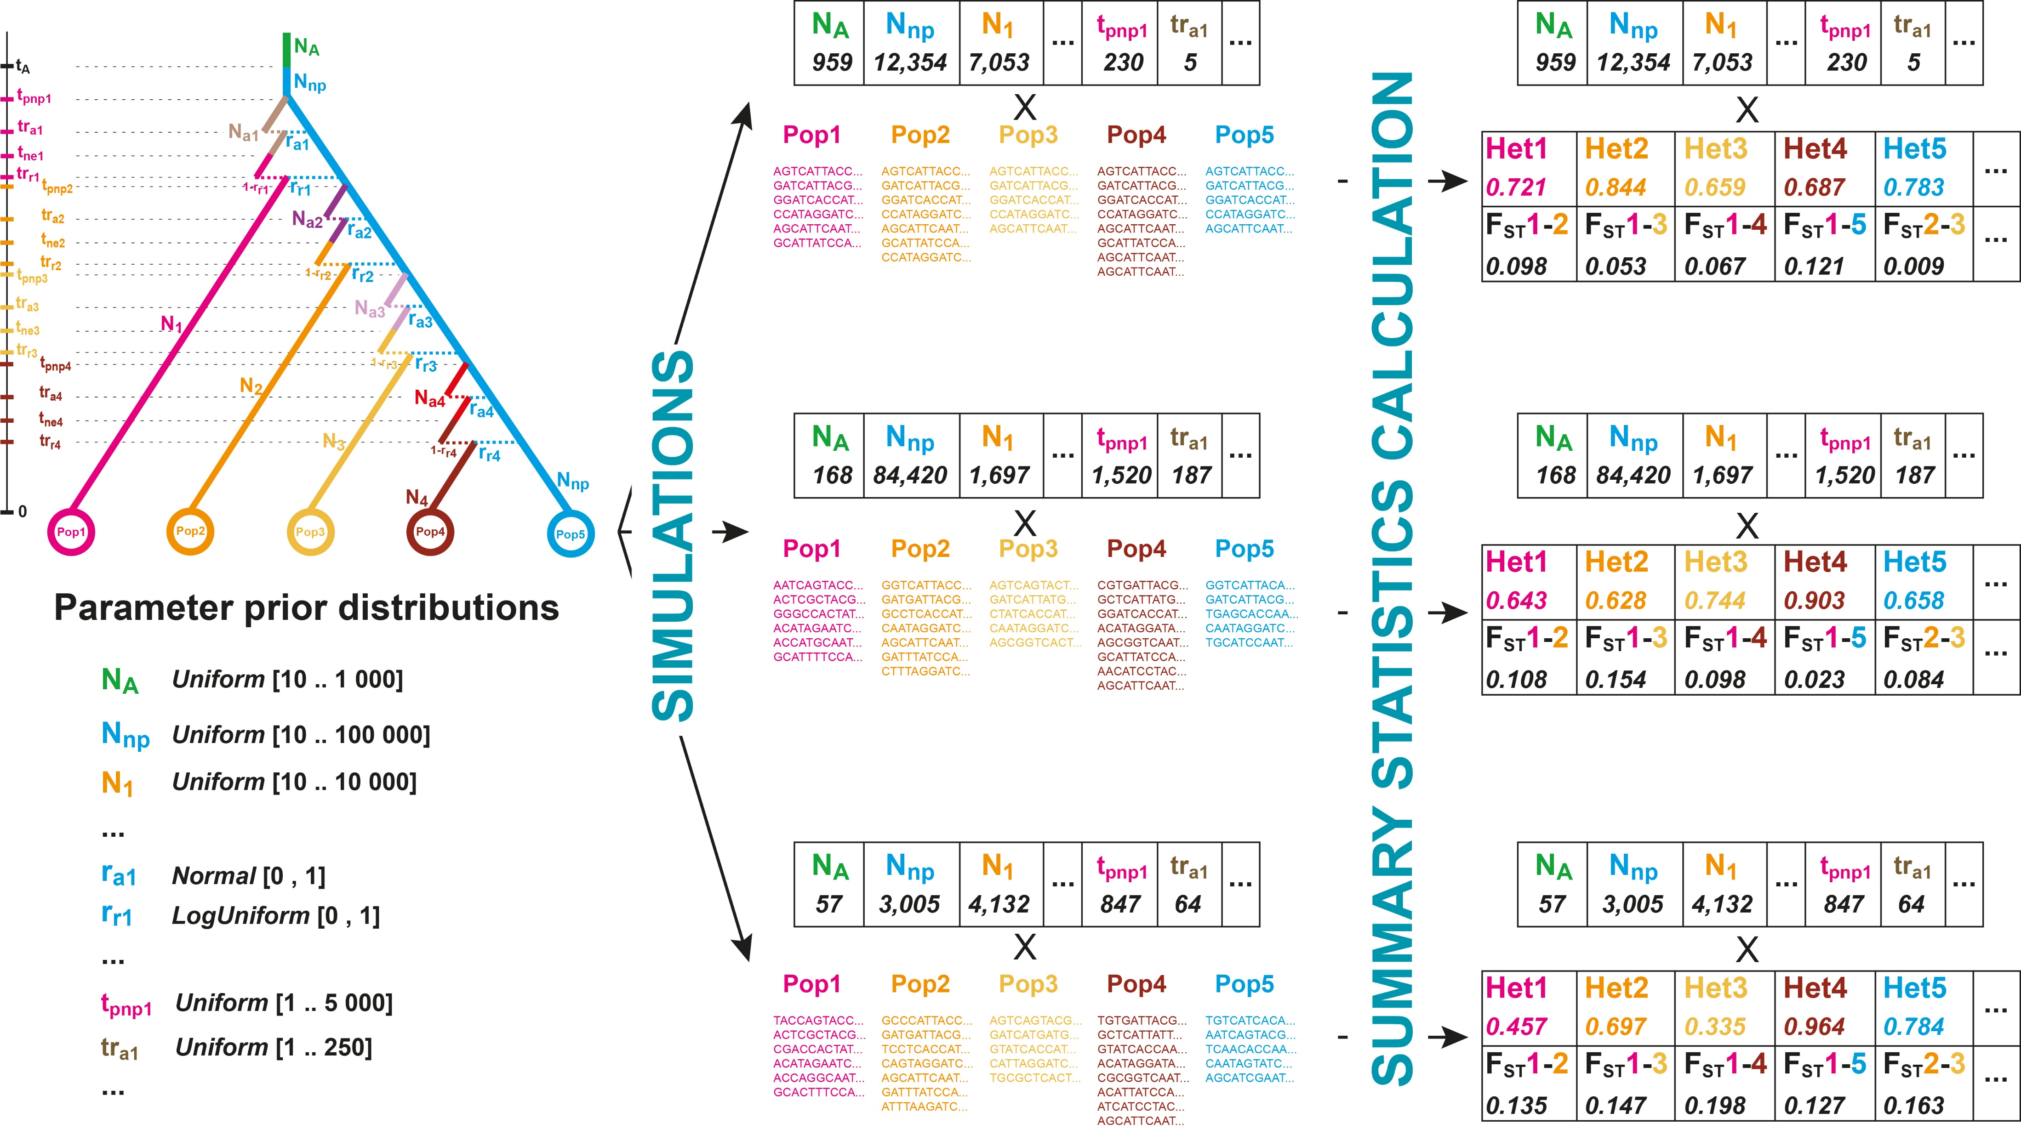
Approximate Bayesian Computation demographic inference
Tavaré et al., Plos Gen 1997
Pritchard et al., Genetics 2000
Beaumont et al., Genetics 2002

Slide 14
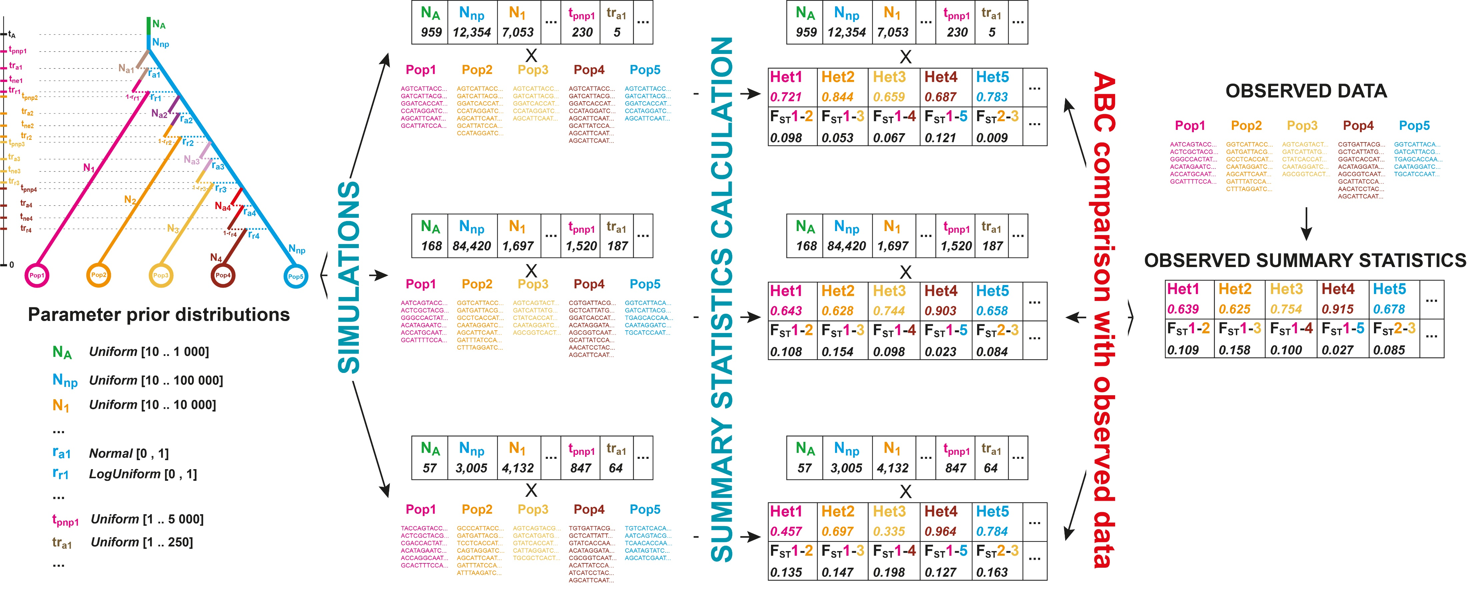
Approximate Bayesian Computation demographic inference
Tavaré et al., Plos Gen 1997
Pritchard et al., Genetics 2000
Beaumont et al., Genetics 2002

Slide 15
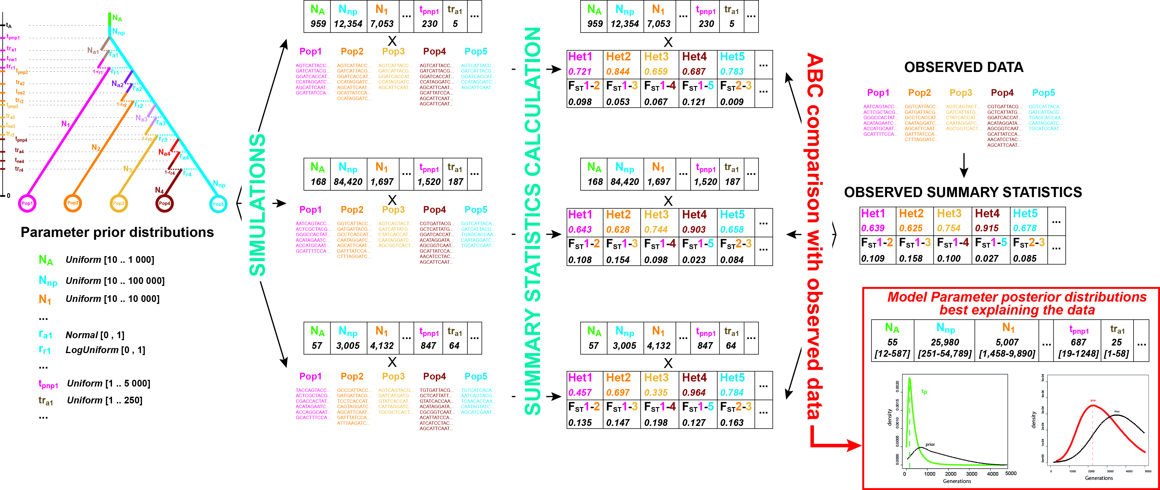
Approximate Bayesian Computation demographic inference
Tavaré et al., Plos Gen 1997
Pritchard et al., Genetics 2000
Beaumont et al., Genetics 2002

Slide 16
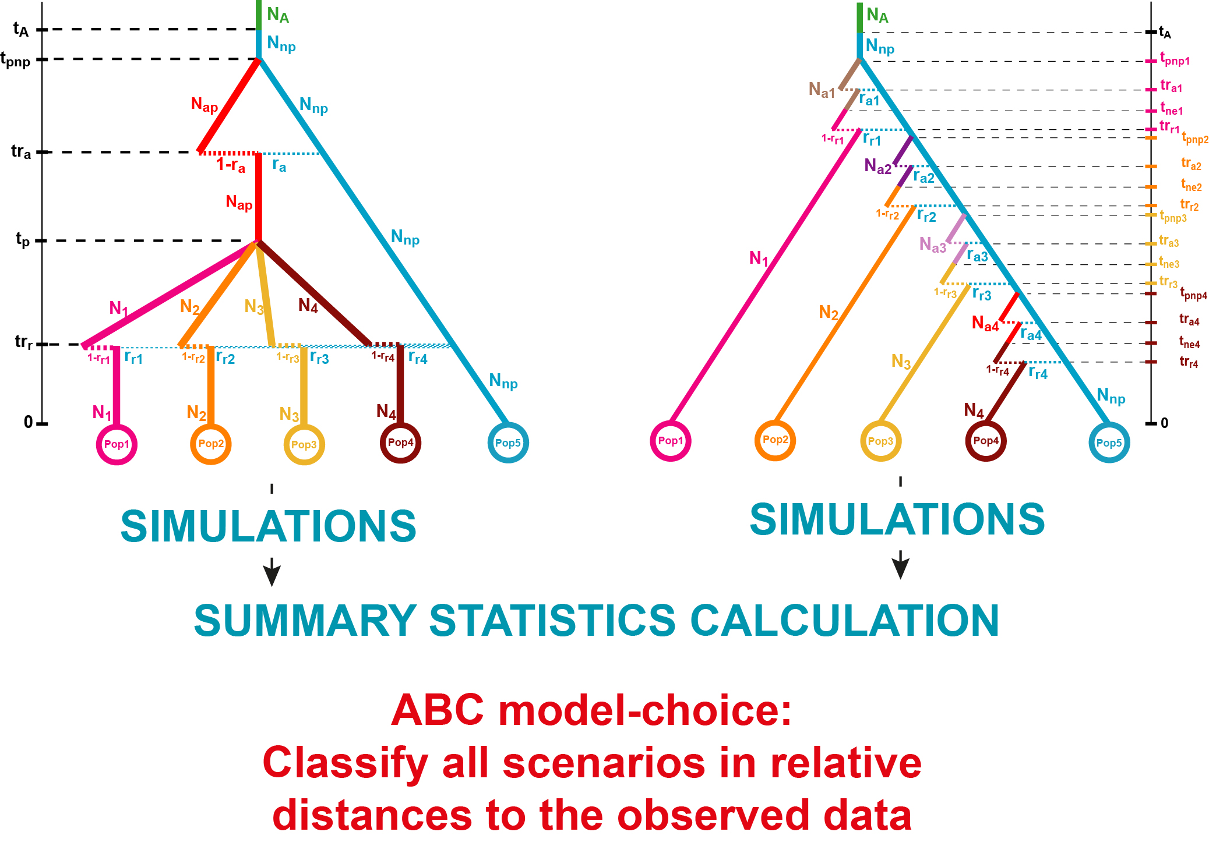
Approximate Bayesian Computation demographic inference
Formal model comparison with ABC
Tavaré et al., Plos Gen 1997
Pritchard et al., Genetics 2000
Beaumont et al., Genetics 2002

Slide 17
Approximate Bayesian Computation for complex admixture history
Approximate Bayesian Computation (Tavaré et al. 1997) represent an alternative ?
$$L\left(ModelParams | {SumStat}_{obs}\right)∝P\left({SumStat}_{obs} | ModelParams\right) P\left(ModelParams\right)$$
If simulations are feasible
If summary-statistics are informative about model-parameters,
► ABC inferences may be successful for the reconstruction of complex admixture histories from genetic data
Tavaré et al., Plos Gen 1997
Pritchard et al., Genetics 2000
Beaumont et al., Genetics 2002

Slide 18
Complex admixture histories reconstructed with MetHis-ABC
If simulations are feasible…

Slide 19
Complex admixture histories reconstructed with MetHis-ABC
If simulations are feasible…
Simulating complex admixture histories under the coalescent is often not trivial:
Different pedigree for each independent locus instead of a single pedigree having, in reality, produced all observed gene genealogies (see Wakeley et al. 2012)
MetHis
genetic data simulator under complex admixture models

Slide 20

MetHis: genetic data simulator under complex admixture histories
► Two source populations version
Fortes-Lima et al., Mol Ecol Res 2021

Slide 21
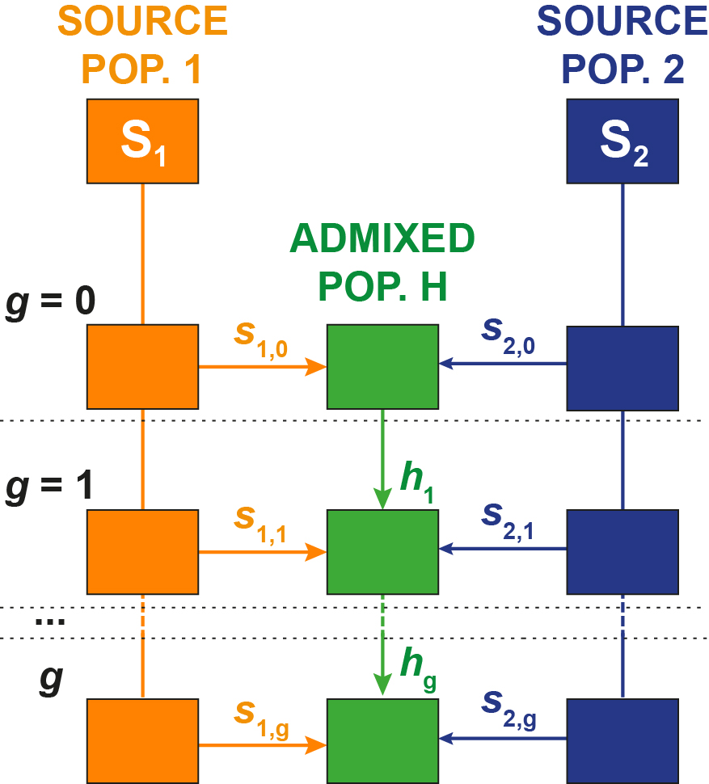
MetHis: genetic data simulator under complex admixture histories
MetHis simulates a panmictic admixed population of diploid size N_{g} at generation g, forward-in-time centered on individuals
Fortes-Lima et al., Mol Ecol Res 2021

Slide 22
MetHis: genetic data simulator under complex admixture histories
MetHis simulates a panmictic admixed population of diploid size N_{g} at generation g, forward-in-time centered on individuals
MetHis simulates any number of autosomal independent genetic loci (SNPs or microsatellites)
Fortes-Lima et al., Mol Ecol Res 2021

Slide 23
MetHis: genetic data simulator under complex admixture histories
MetHis simulates a panmictic admixed population of diploid size N_{g} at generation g, forward-in-time centered on individuals
MetHis simulates any number of autosomal independent genetic loci (SNPs or microsatellites)
1. For each N_{g+1} individuals in population H at generation g+1:
Draw randomly parents in populations S1, S2, and H in proportions s_{1,g}, s_{2,g} and h_{g}
Fortes-Lima et al., Mol Ecol Res 2021

Slide 24
MetHis: genetic data simulator under complex admixture histories
MetHis simulates a panmictic admixed population of diploid size N_{g} at generation g, forward-in-time centered on individuals
MetHis simulates any number of autosomal independent genetic loci (SNPs or microsatellites)
1. For each N_{g+1} individuals in population H at generation g+1:
Draw randomly parents in populations S1, S2, and H in proportions s_{1,g}, s_{2,g} and h_{g}
2. Create haploid gametes for each parent by randomly drawing alleles at each loci
Fortes-Lima et al., Mol Ecol Res 2021

Slide 25
MetHis: genetic data simulator under complex admixture histories
MetHis simulates a panmictic admixed population of diploid size N_{g} at generation g, forward-in-time centered on individuals
MetHis simulates any number of autosomal independent genetic loci (SNPs or microsatellites)
1. For each N_{g+1} individuals in population H at generation g+1:
Draw randomly parents in populations S1, S2, and H in proportions s_{1,g}, s_{2,g} and h_{g}
2. Create haploid gametes for each parent by randomly drawing alleles at each loci
3. Pair gametes to create a new individual in population H, avoiding selfing
Fortes-Lima et al., Mol Ecol Res 2021

Slide 26
MetHis: genetic data simulator under complex admixture histories
MetHis simulates a panmictic admixed population of diploid size N_{g} at generation g, forward-in-time centered on individuals
MetHis simulates any number of autosomal independent genetic loci (SNPs or microsatellites)
1. For each N_{g+1} individuals in population H at generation g+1:
Draw randomly parents in populations S1, S2, and H in proportions s_{1,g}, s_{2,g} and h_{g}
2. Create haploid gametes for each parent by randomly drawing alleles at each loci
3. Pair gametes to create a new individual in population H, avoiding selfing
MetHis simulates a mutation model for microsatellites (GSMM with in/del)
Fortes-Lima et al., Mol Ecol Res 2021

Slide 27
MetHis: genetic data simulator under complex admixture histories
MetHis simulates a panmictic admixed population of diploid size N_{g} at generation g, forward-in-time centered on individuals
MetHis simulates any number of autosomal independent genetic loci (SNPs or microsatellites)
1. For each N_{g+1} individuals in population H at generation g+1:
Draw randomly parents in populations S1, S2, and H in proportions s_{1,g}, s_{2,g} and h_{g}
2. Create haploid gametes for each parent by randomly drawing alleles at each loci
3. Pair gametes to create a new individual in population H, avoiding selfing
MetHis simulates a mutation model for microsatellites (GSMM with in/del)
MetHis does not simulate source populations:
Simulate source populations using existing coalescent simulators
Simulate source populations by drawing alleles in the observed Allelic Frequency Spectrum
Fortes-Lima et al., Mol Ecol Res 2021

Slide 28
MetHis: genetic data simulator under complex admixture histories
MetHis
full two-sources Verdu and Rosenberg 2011 Model
Input a model parameter list at will, provided model definition is respected
Fortes-Lima et al., Mol Ecol Res 2021

Slide 29
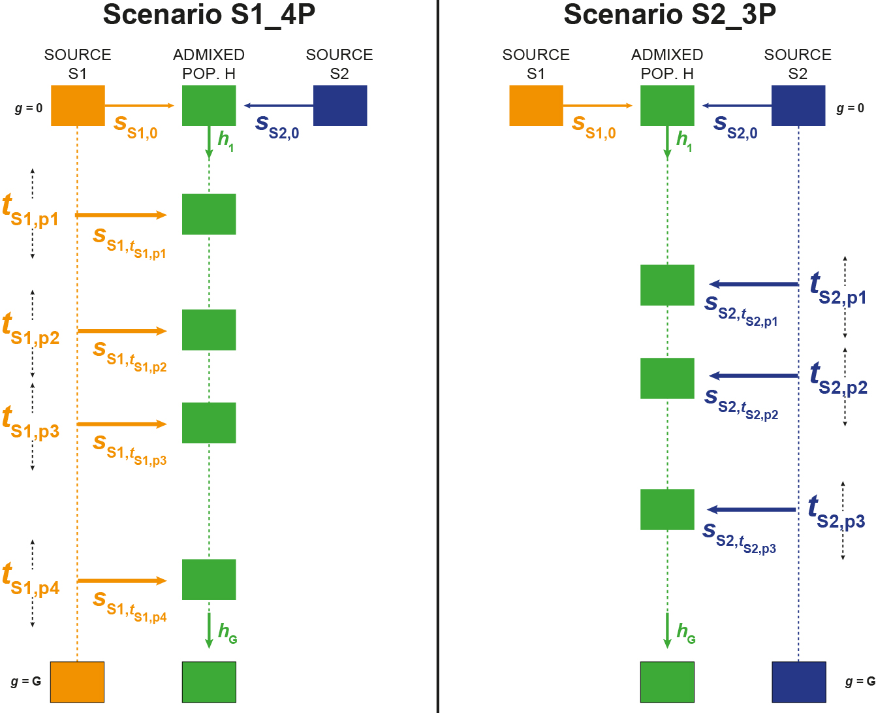
MetHis: genetic data simulator under complex admixture histories
MetHis parameter generator tool
n-pulses of admixture
For each source population separately:
1. Choose number of pulses
2. Choose time priors for each pulse
3. Choose priors for introgression rates for each pulse
MetHis parameter-generator tool builds parameters tables
Fortes-Lima et al., Mol Ecol Res 2021

Slide 30
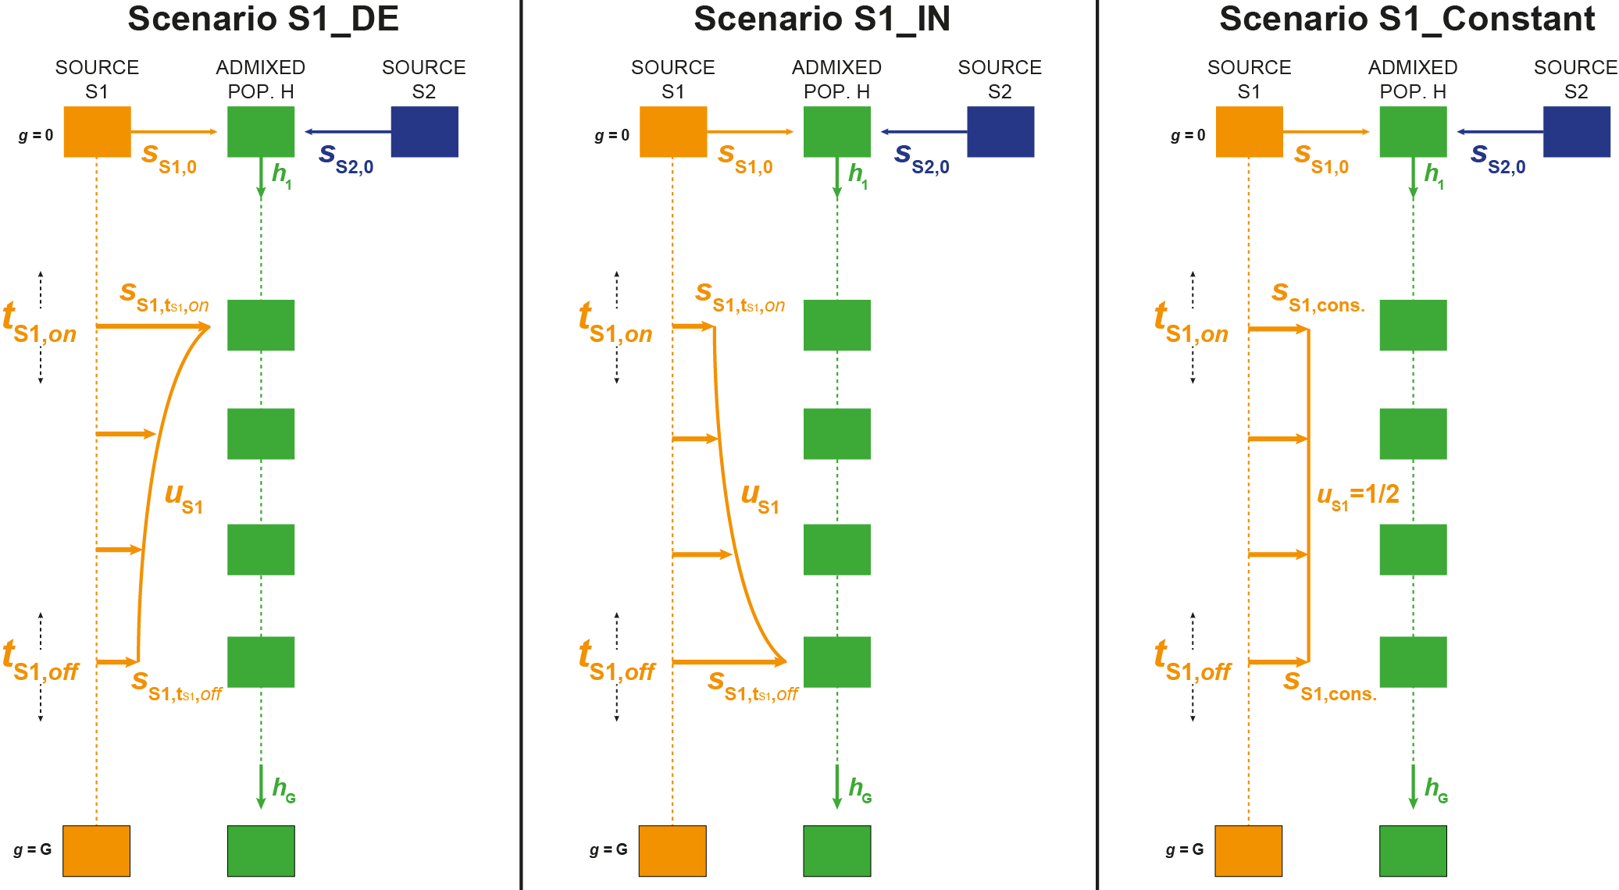
MetHis: genetic data simulator under complex admixture histories
MetHis parameter generator tool
Period of monotonically recurring admixture (rectangular hyperbola)
Fortes-Lima et al., Mol Ecol Res 2021

Slide 31
MetHis: genetic data simulator under complex admixture histories
MetHis parameter generator tool
Period of monotonically recurring admixture (rectangular hyperbola)
For each source population separately:
1. Choose time priors for the beginning and the end of the admixture period
2. Choose priors for introgression rates at the beginning and the end of the admixture period
2. Choose prior for the shape of the scaled rectangular hyperbola
MetHis parameter-generator tool builds parameters tables
Fortes-Lima et al., Mol Ecol Res 2021

Slide 32
Approximate Bayesian Computation for complex admixture history
Approximate Bayesian Computation (Tavaré et al. 1997) represent an alternative ?
$$L\left(ModelParams | {SumStat}_{obs}\right)∝P\left({SumStat}_{obs} | ModelParams\right) P\left(ModelParams\right)$$
If simulations are feasible
If summary-statistics are informative about model-parameters,
► ABC inferences may be successful for the reconstruction of complex admixture histories from genetic data
Tavaré et al., Plos Gen 1997
Pritchard et al., Genetics 2000
Beaumont et al., Genetics 2002

Slide 33
MetHis: summary-statistics calculator for ABC inference
If summary-statistics are informative about model-parameters…

Slide 34
MetHis: summary-statistics calculator for ABC inference
If summary-statistics are informative about model-parameters…
“Classical” population genetics summary-statistics
Expected Heterozygosity (Nei, 1978)
Inbreeding coefficient F (Danecek et al. 2011)
Multilocus pairwise F_{ST} (Weir and Cockerham, 1984)
f₃ (Admixed; S1, S2) (Patterson et al., 2012)
Individual pairwise Allele Sharing Dissimilarities (Bowcock et al., 1994)
Fortes-Lima et al., Mol Ecol Res 2021

Slide 35
MetHis: summary-statistics calculator for ABC inference
If summary-statistics are informative about model-parameters…
“Classical” population genetics summary-statistics
Expected Heterozygosity (Nei, 1978)
Inbreeding coefficient F (Danecek et al. 2011)
Multilocus pairwise F_{ST} (Weir and Cockerham, 1984)
f₃ (Admixed; S1, S2) (Patterson et al., 2012)
Individual pairwise Allele Sharing Dissimilarities (Bowcock et al., 1994)
What about individual admixture estimates ?
Fortes-Lima et al., Mol Ecol Res 2021

Slide 36
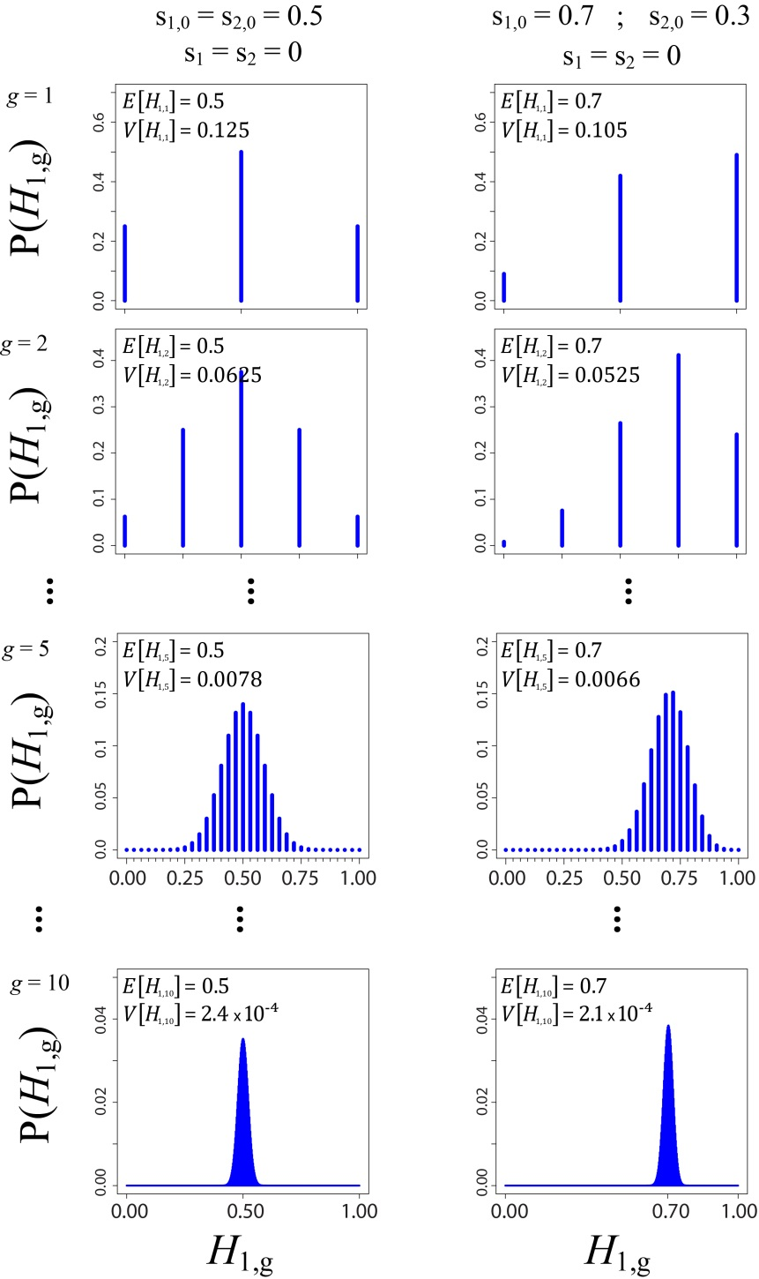

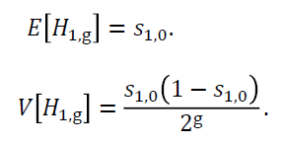
MetHis: summary-statistics calculator for ABC inference
The moments of the distribution of admixture fractions in the admixed population are informative about the underlying admixture process
Verdu and Rosenberg, Genetics 2011

Slide 37
MetHis: summary-statistics calculator for ABC inference
The moments of the distribution of admixture fractions in the admixed population are informative about the underlying admixture process
Use the distribution of admixture fractions as an ABC-informative summary statistics !
Verdu and Rosenberg, Genetics 2011

Slide 38
MetHis: summary-statistics calculator for ABC inference
ML methods to estimate admixture fractions (e.g ADMIXTURE, Alexander et al. 2009):
Computationally very intensive and difficult to compute for numerous simulations (>10K) for ABC inference
Fortes-Lima et al., Mol Ecol Res 2021

Slide 39
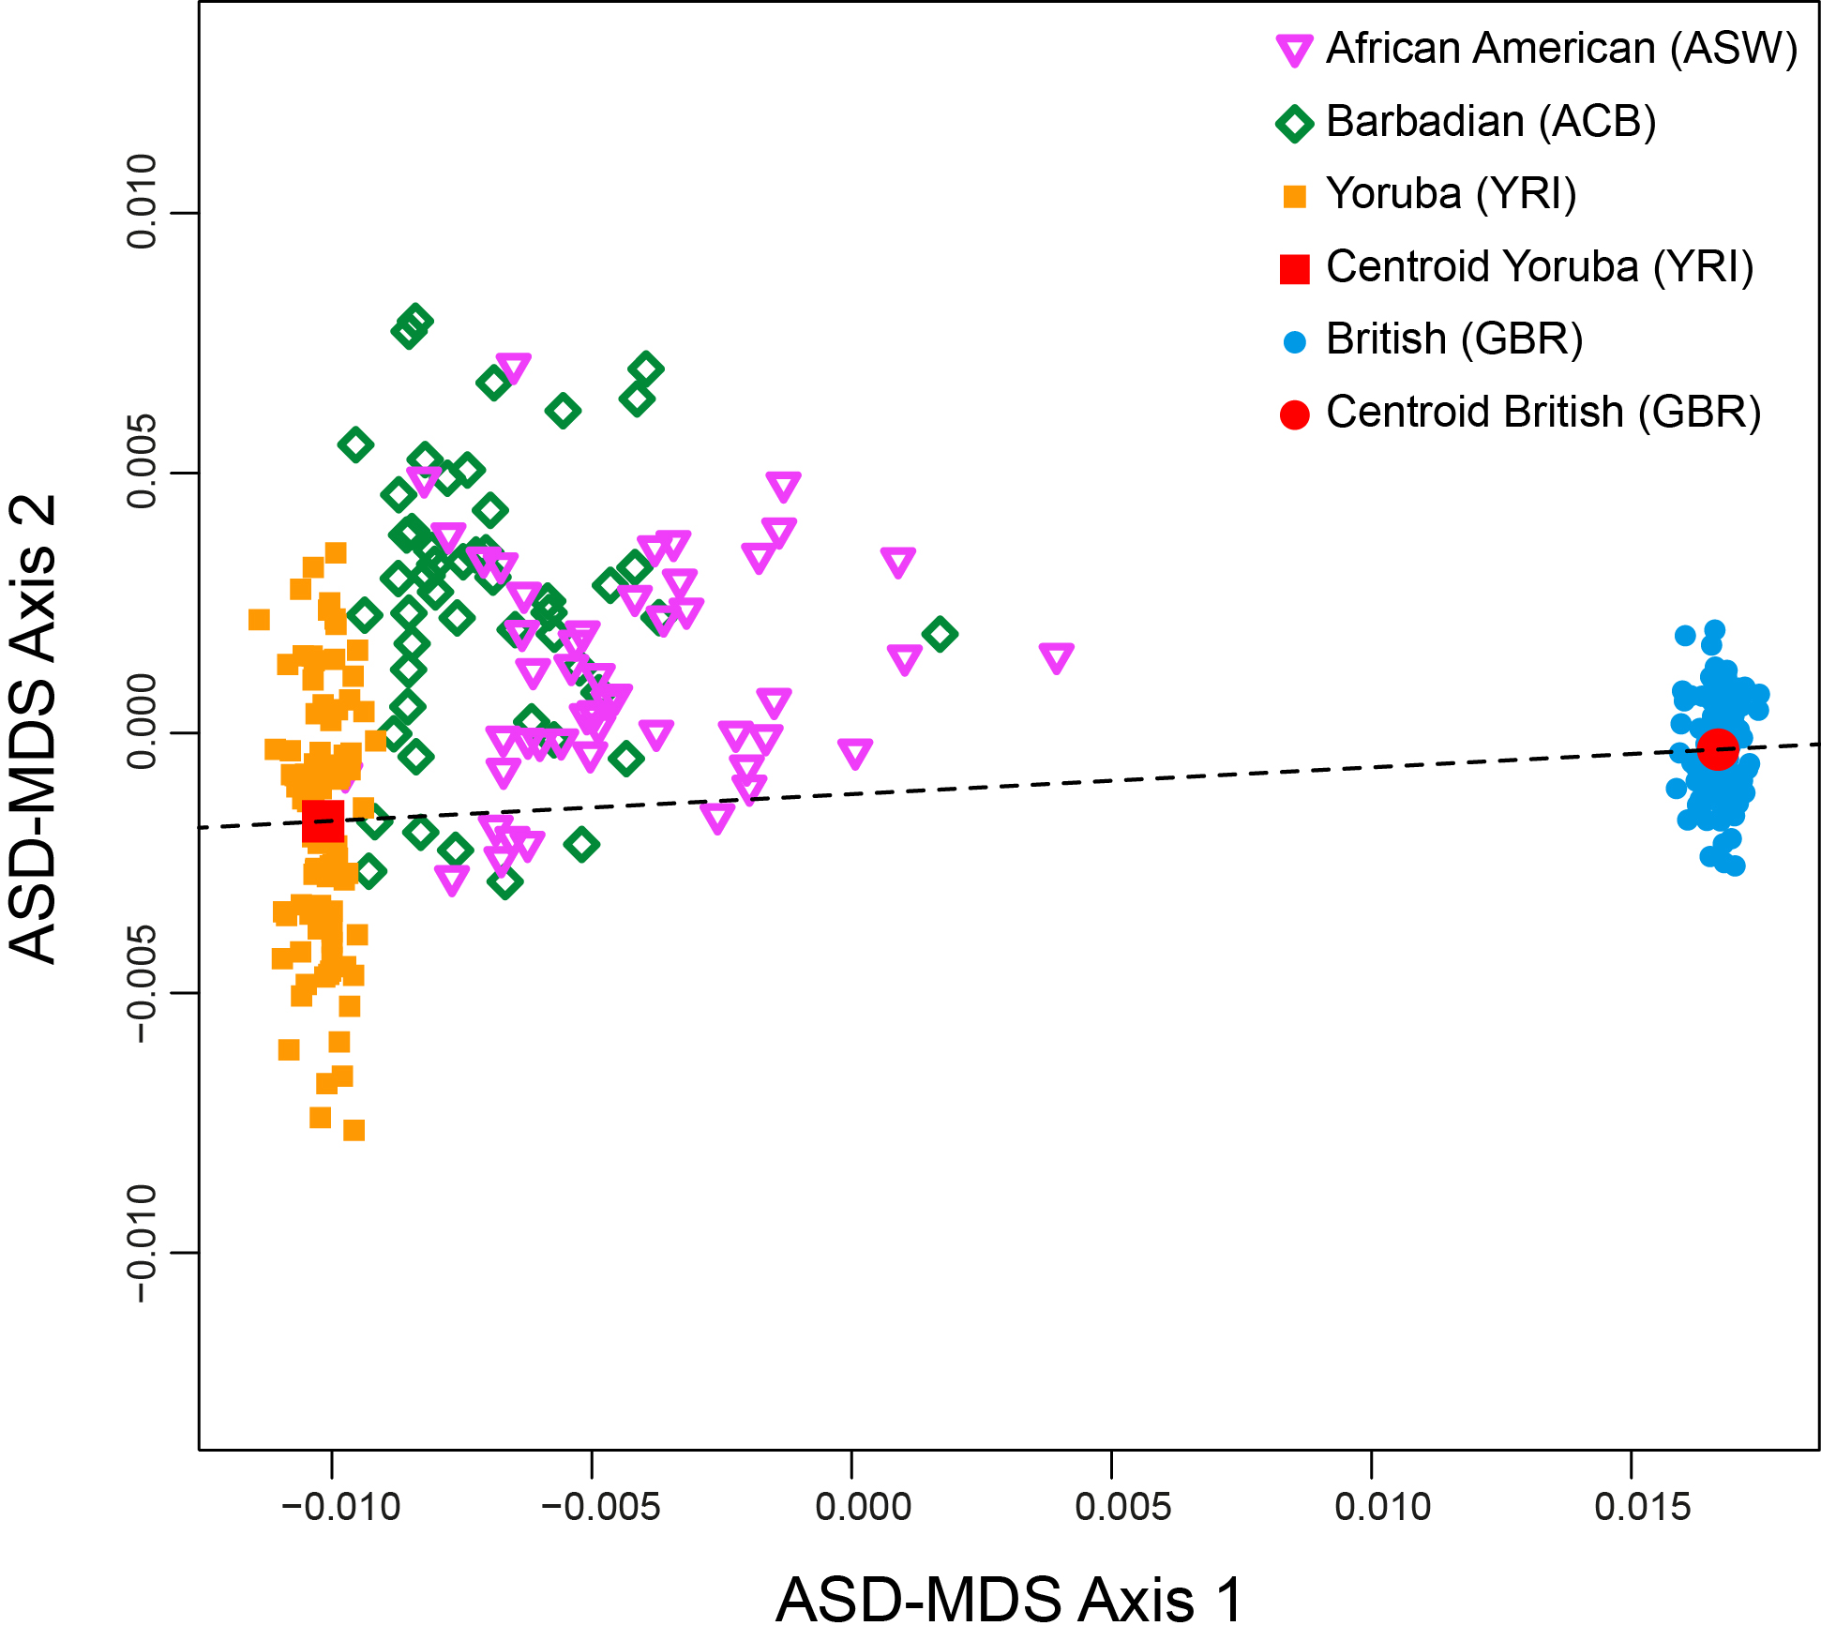
MetHis: summary-statistics calculator for ABC inference
ML methods to estimate admixture fractions (e.g ADMIXTURE, Alexander et al. 2009):
Computationally very intensive and difficult to compute for numerous simulations (>10K) for ABC inference
Allele Sharing Dissimilarity (Bowcock et al. 1994)-MDS based individual admixture fraction estimation
Fortes-Lima et al., Mol Ecol Res 2021

Slide 40
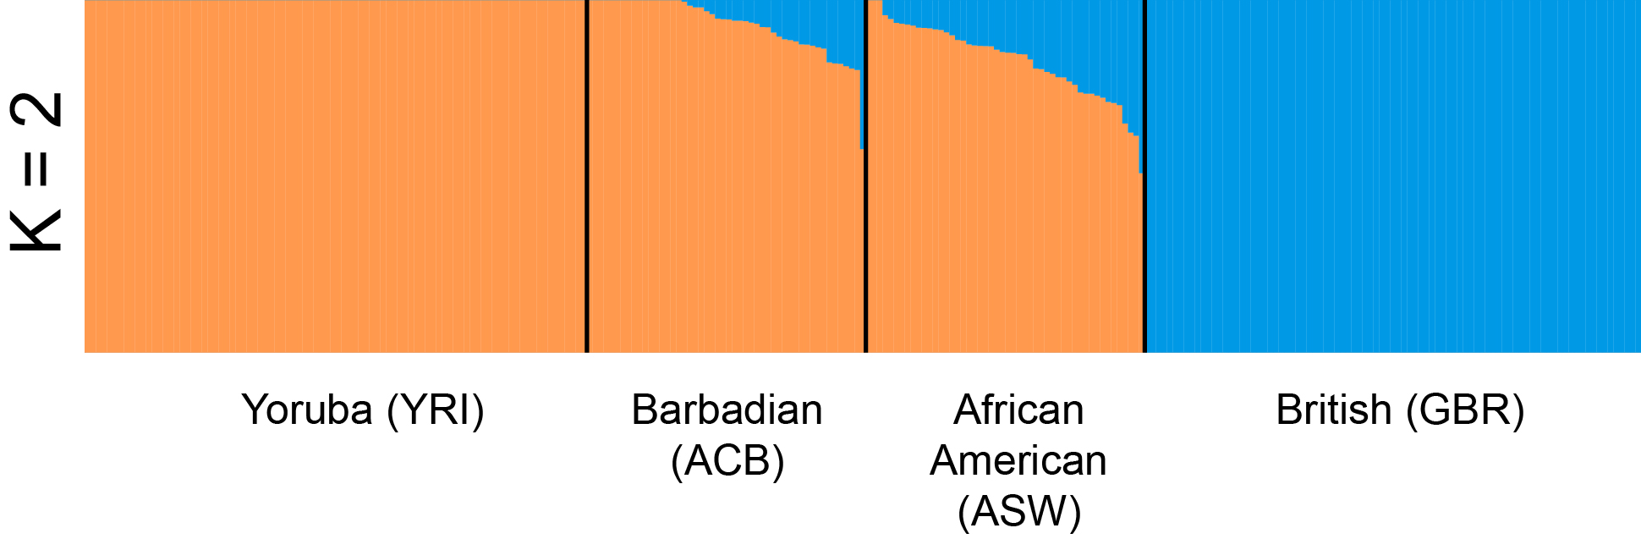
MetHis: summary-statistics calculator for ABC inference
ML methods to estimate admixture fractions (e.g ADMIXTURE, Alexander et al. 2009):
Computationally very intensive and difficult to compute for numerous simulations (>10K) for ABC inference
Allele Sharing Dissimilarity (Bowcock et al. 1994)-MDS based individual admixture fraction estimation
Fortes-Lima et al., Mol Ecol Res 2021

Slide 41
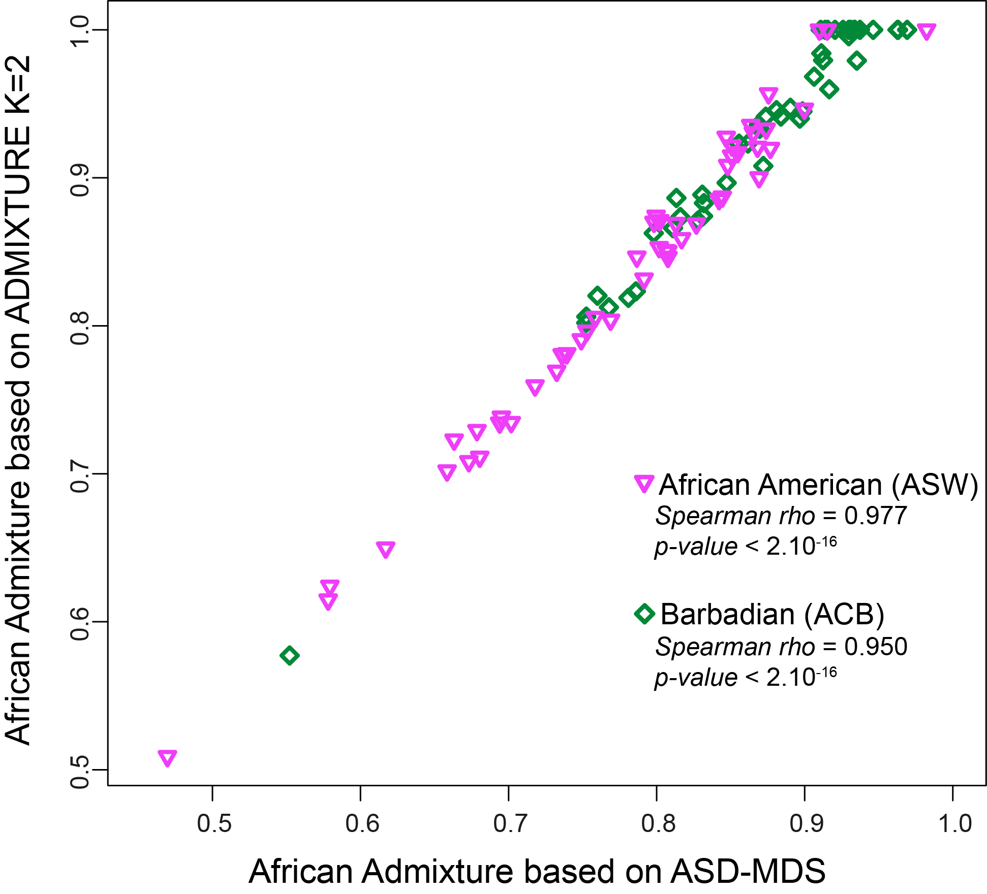
MetHis: summary-statistics calculator for ABC inference
ML methods to estimate admixture fractions (e.g ADMIXTURE, Alexander et al. 2009):
Computationally very intensive and difficult to compute for numerous simulations (>10K) for ABC inference
Allele Sharing Dissimilarity (Bowcock et al. 1994)-MDS based individual admixture fraction estimation
Fortes-Lima et al., Mol Ecol Res 2021

Slide 42
MetHis: summary-statistics calculator for ABC inference
If summary-statistics are informative about model-parameters…
“Classical” population genetics summary-statistics
Expected Heterozygosity (Nei, 1978)
Inbreeding coefficient F (Danecek et al. 2011)
Multilocus pairwise F_{ST} (Weir and Cockerham, 1984)
f₃ (Admixed; S1, S2) (Patterson et al., 2012)
Individual pairwise Allele Sharing Dissimilarities (Bowcock et al., 1994)
ASD-MDS admixture fractions
Min and Max admixture fractions
10% quantiles of individual admixture fractions
Mode, Mean, Variance, Kurtosis, Skewness of individual admixture fractions
Fortes-Lima et al., Mol Ecol Res 2021

Slide 43
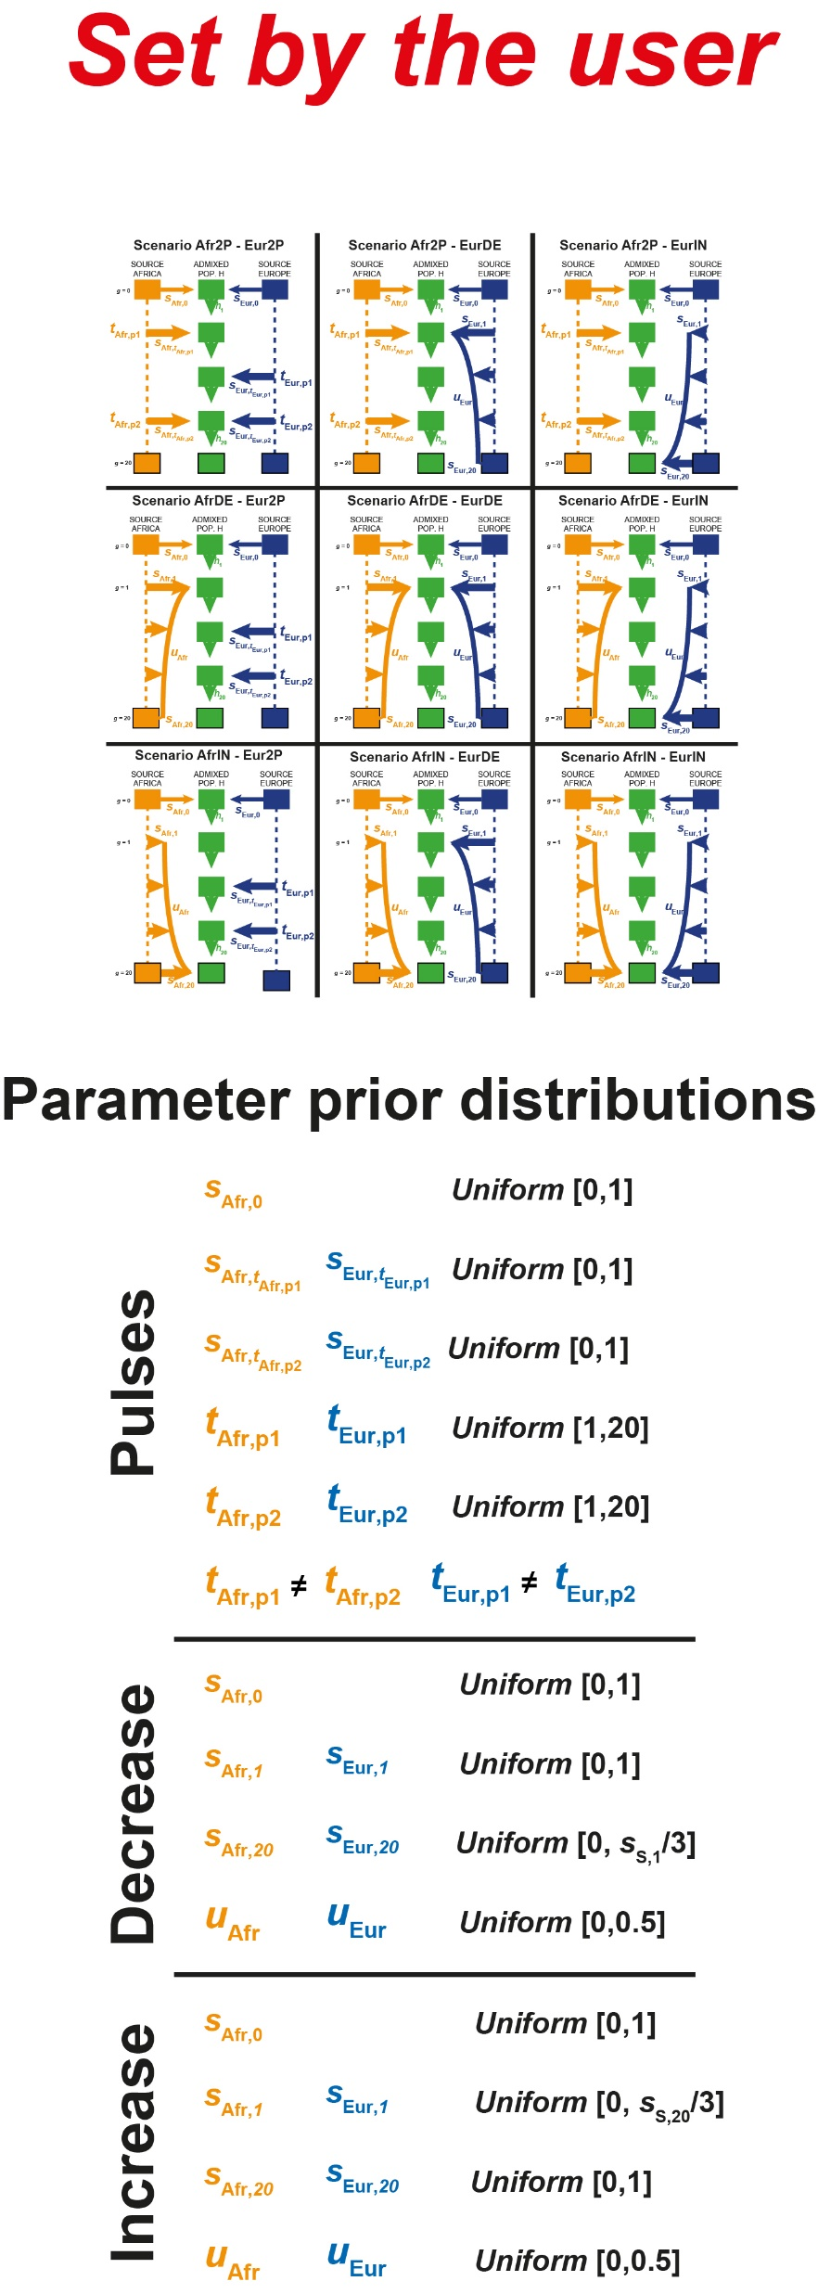
Complex admixture histories reconstructed with MetHis-ABC
Fortes-Lima et al., Mol Ecol Res 2021

Slide 44
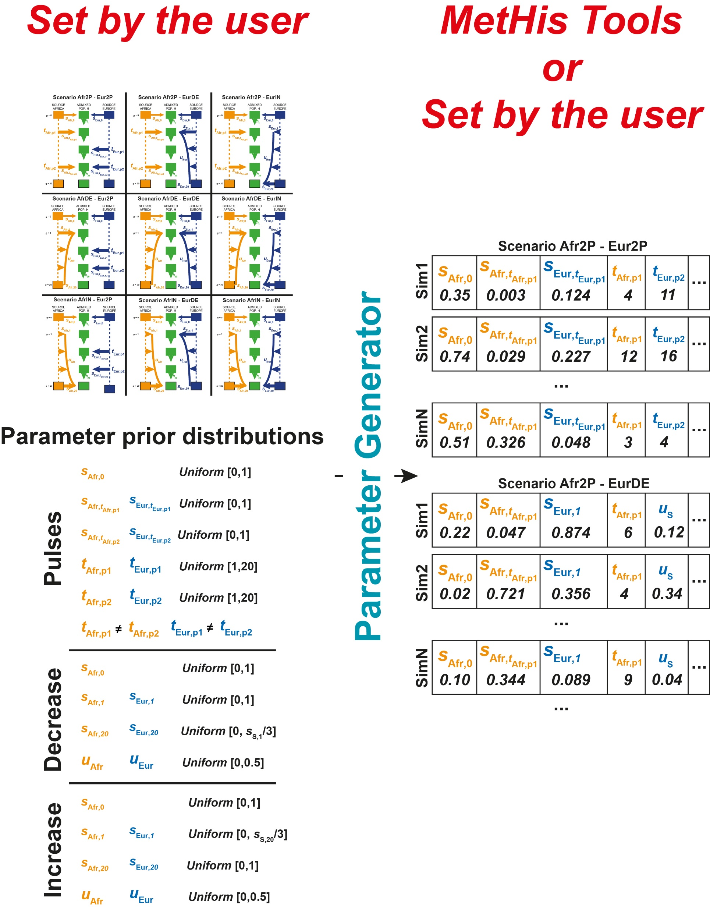
Complex admixture histories reconstructed with MetHis-ABC
Fortes-Lima et al., Mol Ecol Res 2021

Slide 45
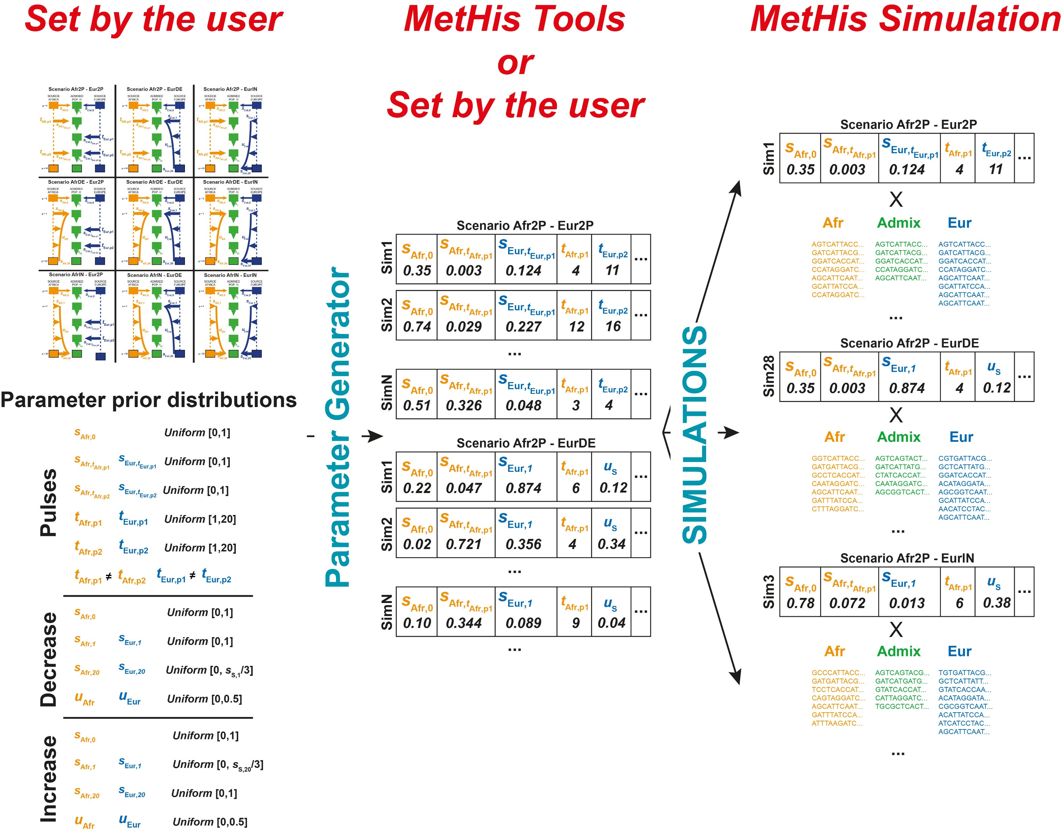
Complex admixture histories reconstructed with MetHis-ABC
Fortes-Lima et al., Mol Ecol Res 2021

Slide 46
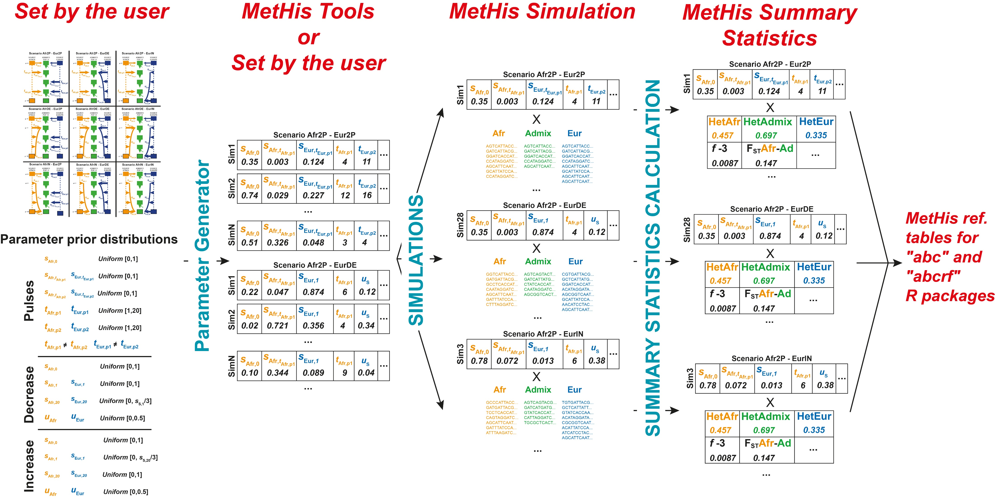
Complex admixture histories reconstructed with MetHis-ABC
Fortes-Lima et al., Mol Ecol Res 2021

Slide 47
Complex admixture histories reconstructed with MetHis-ABC
It is (about) time that we see whether all this works in reality !

Slide 48

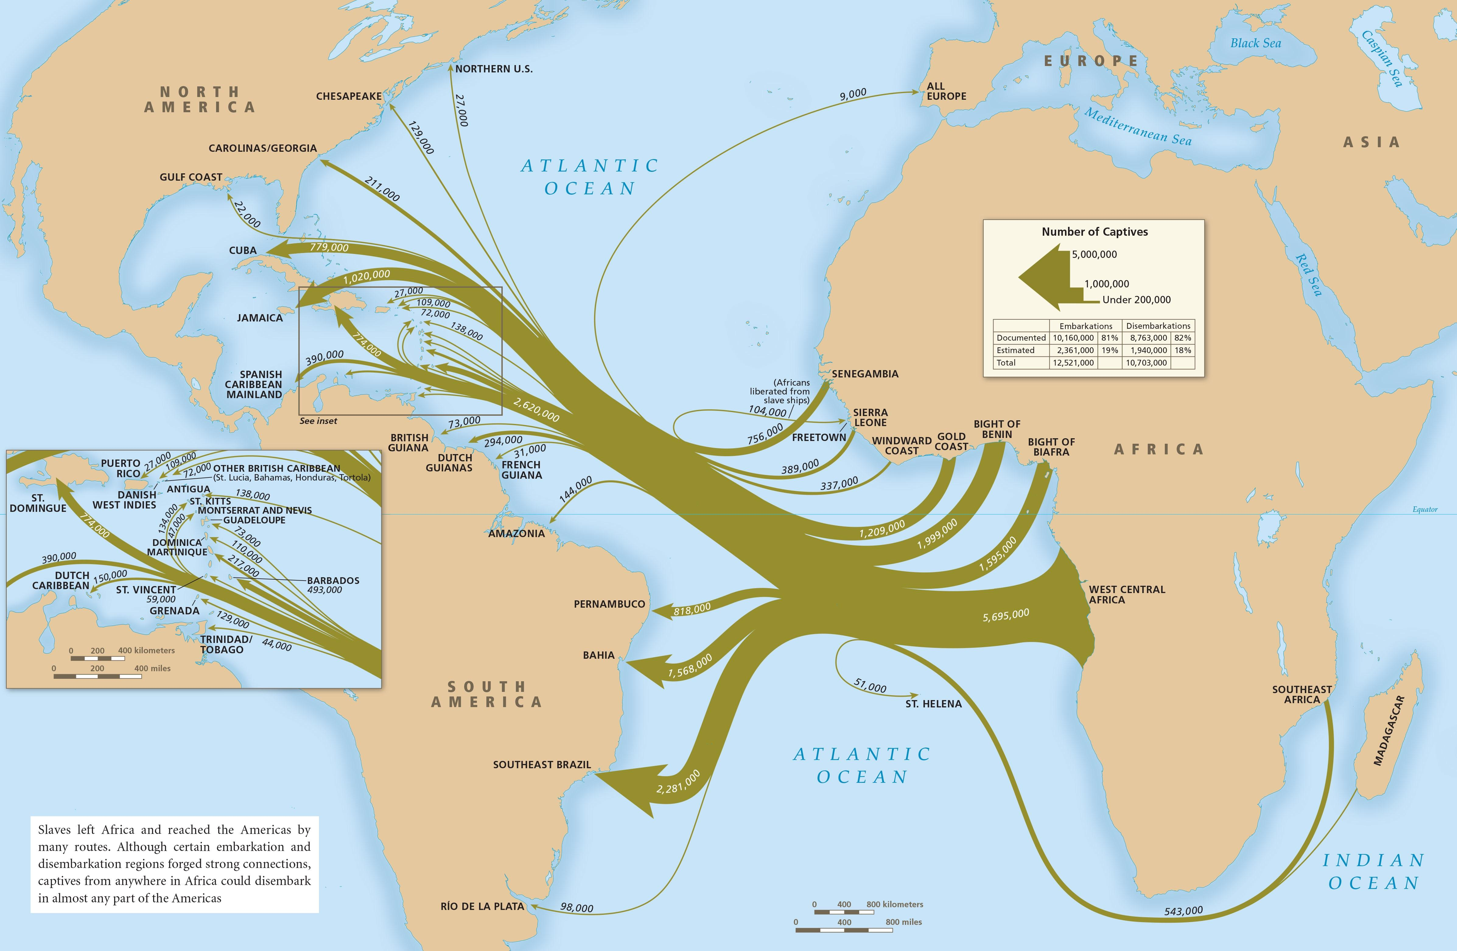
Case study: Admixture history of the Afro-American and Barbadian populations from the 1KGP
Transatlantic Slave Trade:
► Recent admixture history (~20 generations)
► Variable migration histories to the Americas
► Variable slavery histories in the Americas
Fortes-Lima and Verdu, Hum Mol Gen 2021

Slide 49
Case study: Admixture history of the Afro-American and Barbadian populations from the 1KGP
Transatlantic Slave Trade:
► Recent admixture history (~20 generations)
► Variable migration histories to the Americas
► Variable slavery histories in the Americas
Previous studies tested 2 admixture pulses at most, with ML methods using >> 1 million SNPs
They found that 2 admixture pulses from Europe were most likely… but cannot try more complex models.
Gravel, Genetics 2012
Baharian et al., Plos Gen 2016
Fortes-Lima and Verdu, Hum Mol Gen 2021

Slide 50
Case study: Admixture history of the Afro-American and Barbadian populations from the 1KGP
Real Data Set
Previous studies found two proxy source populations for the admixture patterns in Afro-American and Barbadian populations: British (GBR) and Yoruba (YRI)
► Two source population admixture models
1000 Genomes Project Phase 3:
British (GBR) ► 89 unrelated individuals
Yoruba (YRI) ► 90 unrelated individuals
Afro-American (ASW) ► 50 unrelated individuals
Barbadian (ACB) ► 50 unrelated individuals
► 100,000 independent SNPs (no singleton, window = 100 SNPs, moving = 10 SNPs, r² < 0.1, random draw)
Fortes-Lima et al., Mol Ecol Res 2021

Slide 51
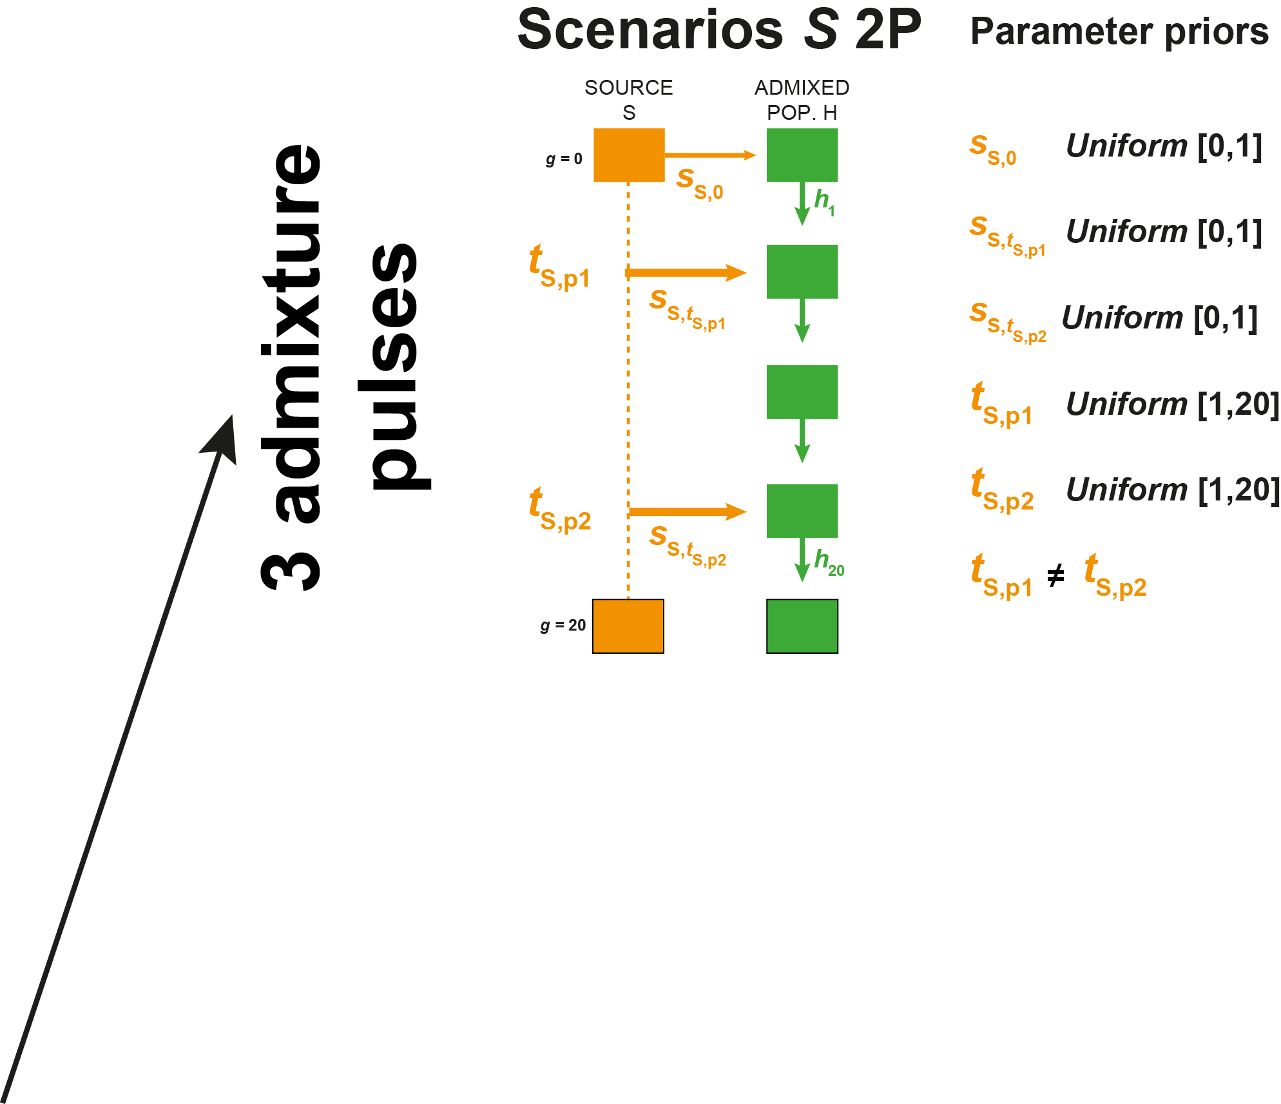
Nine competing models for the admixture history of the ASW and the ACB
21 generations before present (g = 20)
= Admixed population founded ~ 1500s
Fortes-Lima et al., Mol Ecol Res 2021

Slide 52
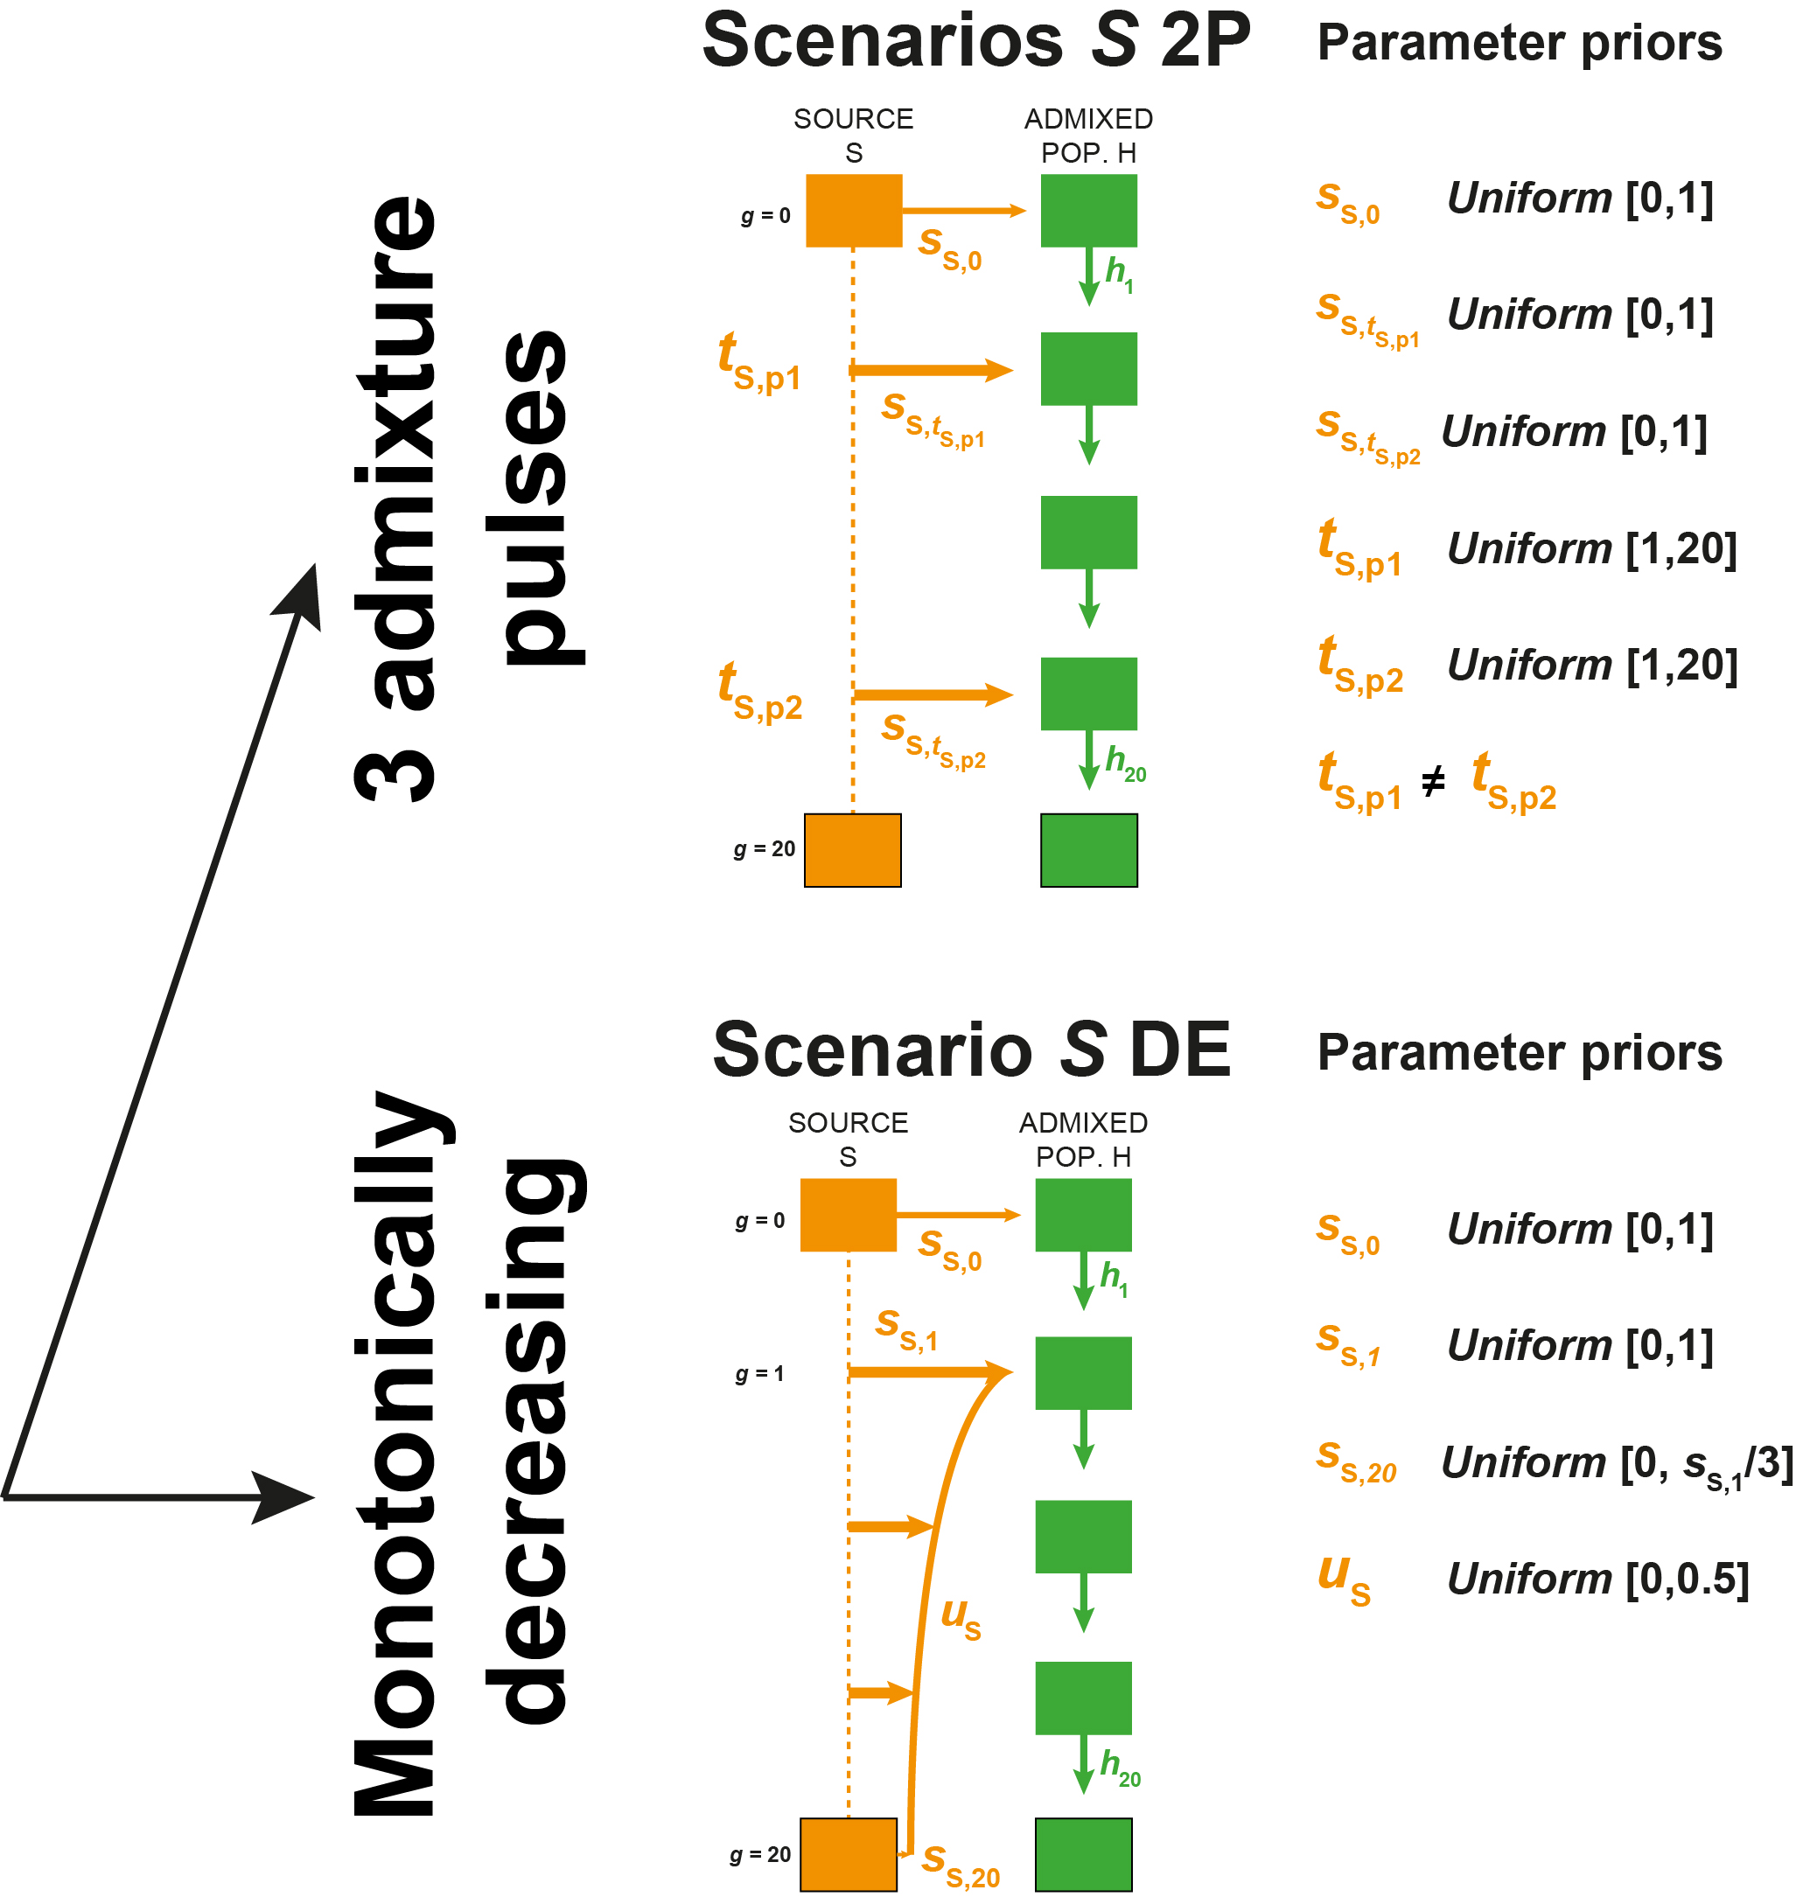
Nine competing models for the admixture history of the ASW and the ACB
21 generations before present (g = 20)
= Admixed population founded ~ 1500s
Fortes-Lima et al., Mol Ecol Res 2021

Slide 53
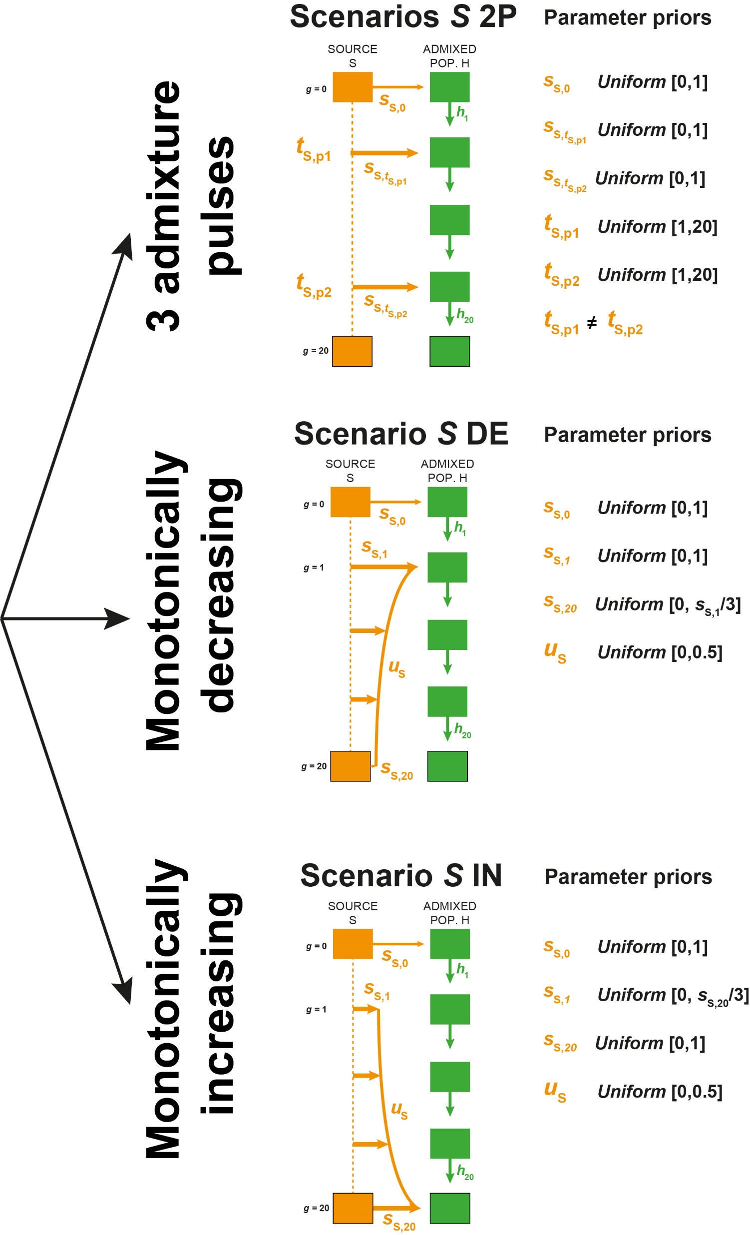
Nine competing models for the admixture history of the ASW and the ACB
21 generations before present (g = 20)
= Admixed population founded ~ 1500s
Flip the monotonic-decrease case !
Fortes-Lima et al., Mol Ecol Res 2021

Slide 54
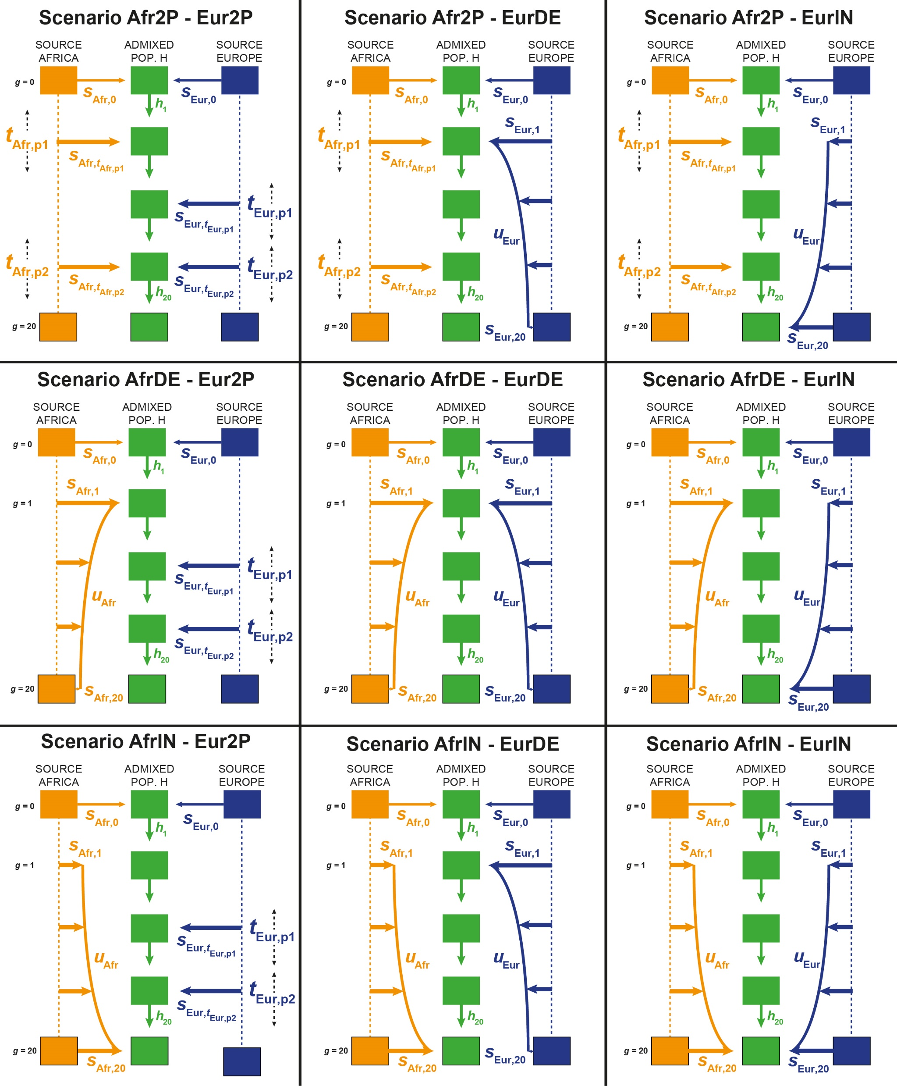
Nine competing models for the admixture history of the ASW and the ACB
21 generations before present (g = 20)
= Admixed population founded ~ 1500s
Fortes-Lima et al., Mol Ecol Res 2021

Slide 55
Nine competing models for the admixture history of the ASW and the ACB
100,000 independent SNPs
N_{g} = constant 1,000 individuals (for simplicity here, MetHis option)
No mutation (for simplicity, 21 generations process, MetHis option)
10,000 simulations per model = 90,000 simulations total
Sample 90 Africans, 89 Europeans, and 50 individuals in the admixed population.
No related individuals at the 2nd degree (MetHis option)
Fortes-Lima et al., Mol Ecol Res 2021

Slide 56
Nine competing models for the admixture history of the ASW and the ACB
100,000 independent SNPs
N_{g} = constant 1,000 individuals (for simplicity here, MetHis option)
No mutation (for simplicity, 21 generations process, MetHis option)
10,000 simulations per model = 90,000 simulations total
Sample 90 Africans, 89 Europeans, and 50 individuals in the admixed population.
No related individuals at the 2nd degree (MetHis option)
For each simulated data set, calculate 24 summary statistics:
Mean(Het), Var(Het), FST(Afr-H), FST(Eur-H), f3(H; Afr,Eur), Mean ASD, Var ASD,…
+ 16 statistics for admixture fraction distribution in population H.
Fortes-Lima et al., Mol Ecol Res 2021

Slide 57
Nine competing models for the admixture history of the ASW and the ACB
100,000 independent SNPs
N_{g} = constant 1,000 individuals (for simplicity here, MetHis option)
No mutation (for simplicity, 21 generations process, MetHis option)
10,000 simulations per model = 90,000 simulations total
Sample 90 Africans, 89 Europeans, and 50 individuals in the admixed population.
No related individuals at the 2nd degree (MetHis option)
For each simulated data set, calculate 24 summary statistics:
Mean(Het), Var(Het), FST(Afr-H), FST(Eur-H), f3(H; Afr,Eur), Mean ASD, Var ASD,…
+ 16 statistics for admixture fraction distribution in population H.
27 cores -> 3 days calculation total.
2/3 of this time = summary statistics calculation…
Simulation time increases with Ne much more rapidly than with g.
Fortes-Lima et al., Mol Ecol Res 2021

Slide 58
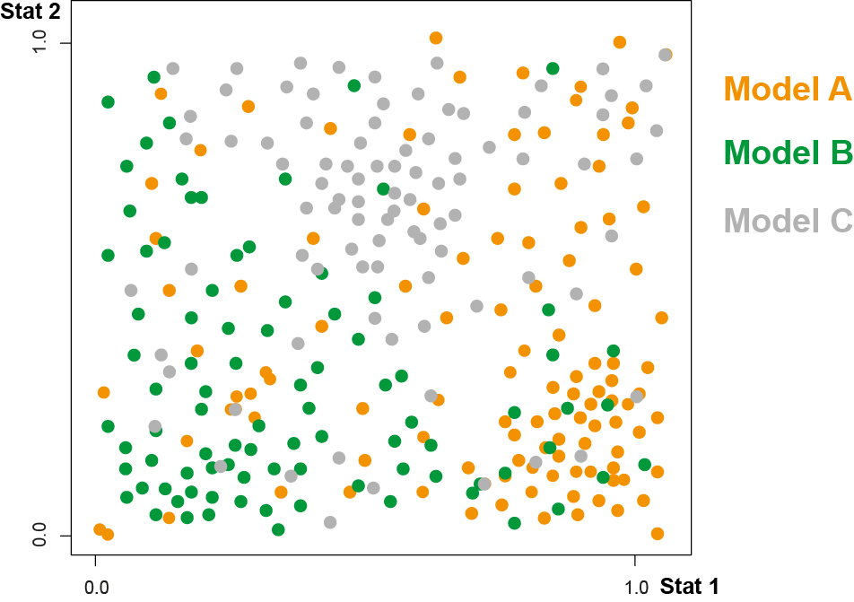

Random Forest algorithm for model choice (Breiman 2001)
Draw randomly Stats order
Build Decision Tree 1

Slide 59
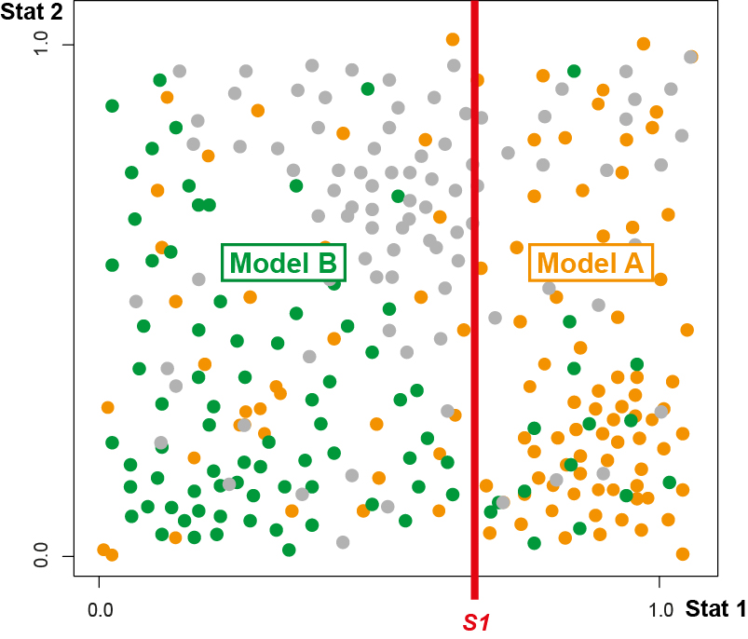
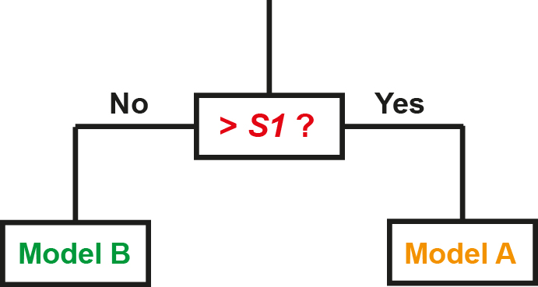
Random Forest algorithm for model choice (Breiman 2001)
Draw randomly Stats order
Build Decision Tree 1

Slide 60
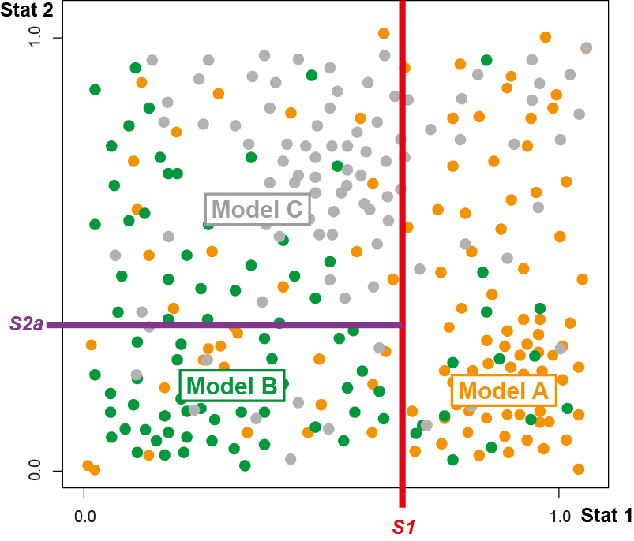
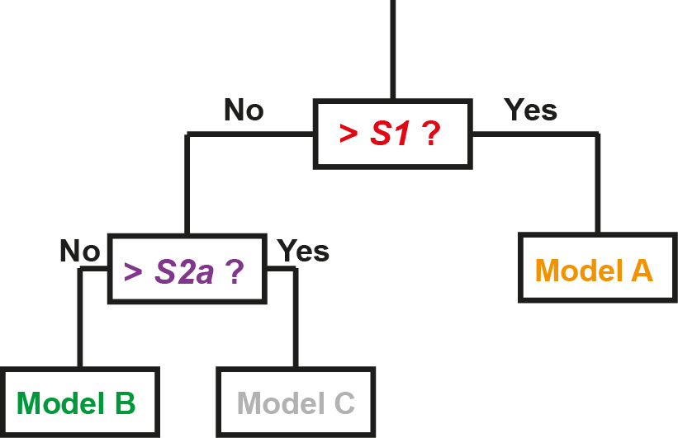
Random Forest algorithm for model choice (Breiman 2001)
Draw randomly Stats order
Build Decision Tree 1

Slide 61
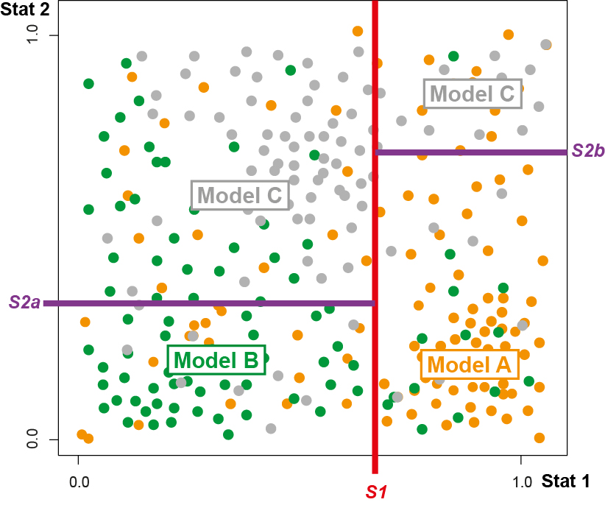
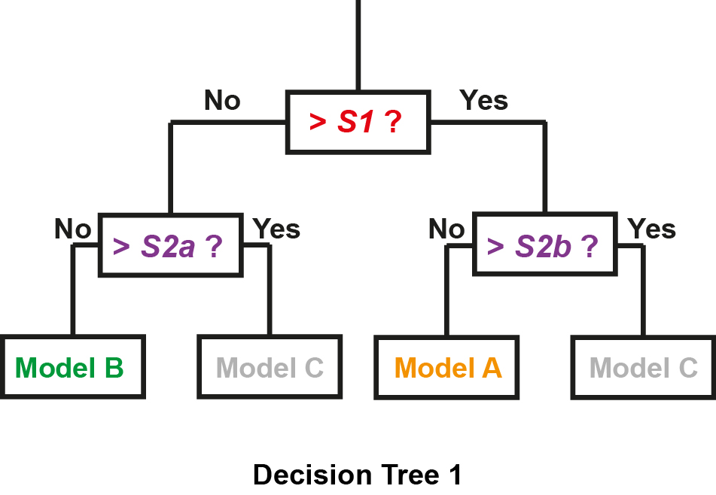
Random Forest algorithm for model choice (Breiman 2001)
Draw randomly Stats order
Build Decision Tree 1

Slide 62
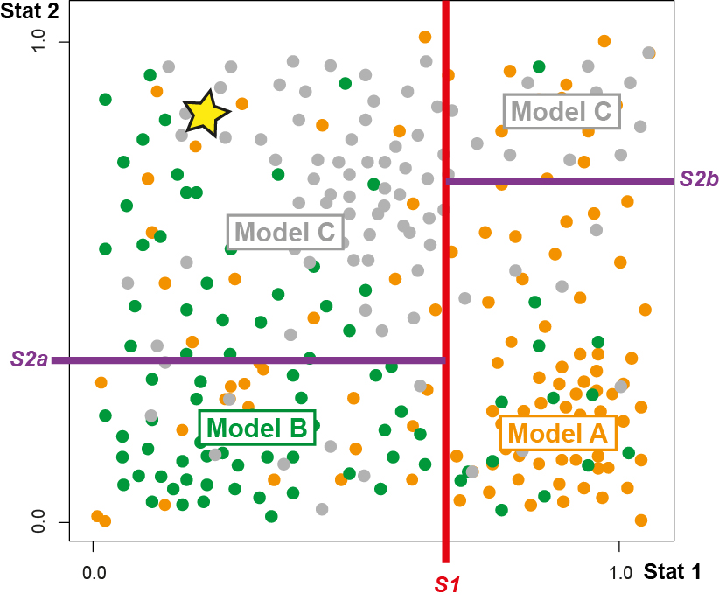
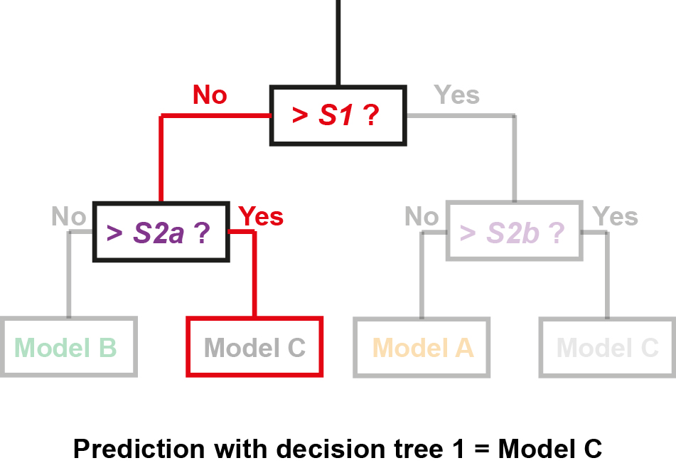
Random Forest algorithm for model choice (Breiman 2001)
Draw randomly Stats order
Build Decision Tree 1

Slide 63
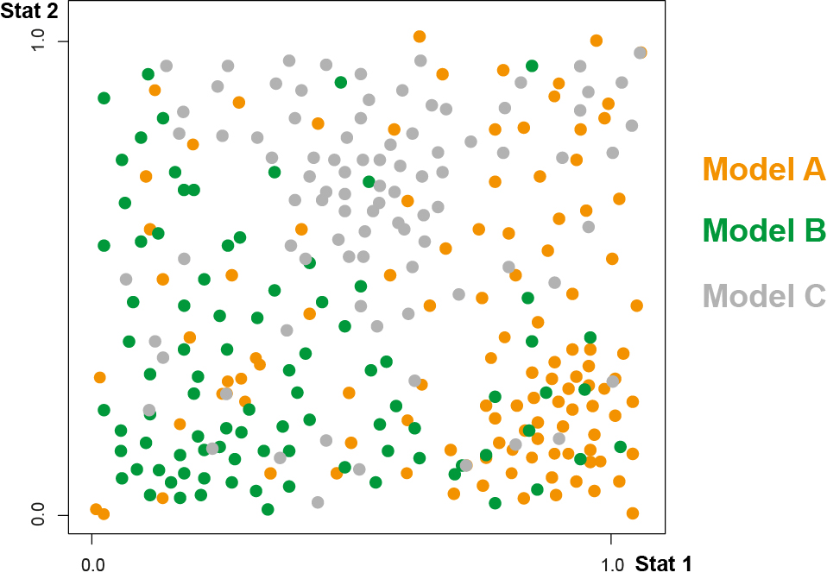
Random Forest algorithm for model choice (Breiman 2001)
Draw randomly Stats order
Build Decision Tree 1
Draw randomly Stats order
Build Decision Tree 2

Slide 64
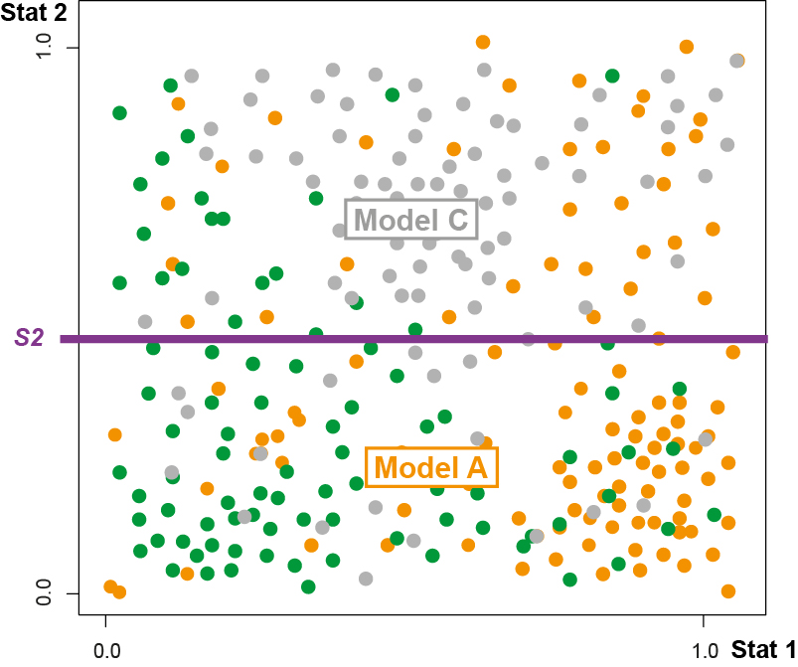
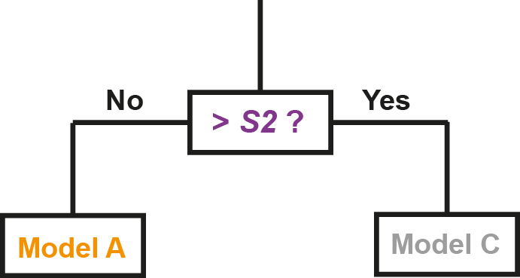
Random Forest algorithm for model choice (Breiman 2001)
Draw randomly Stats order
Build Decision Tree 1
Draw randomly Stats order
Build Decision Tree 2

Slide 65
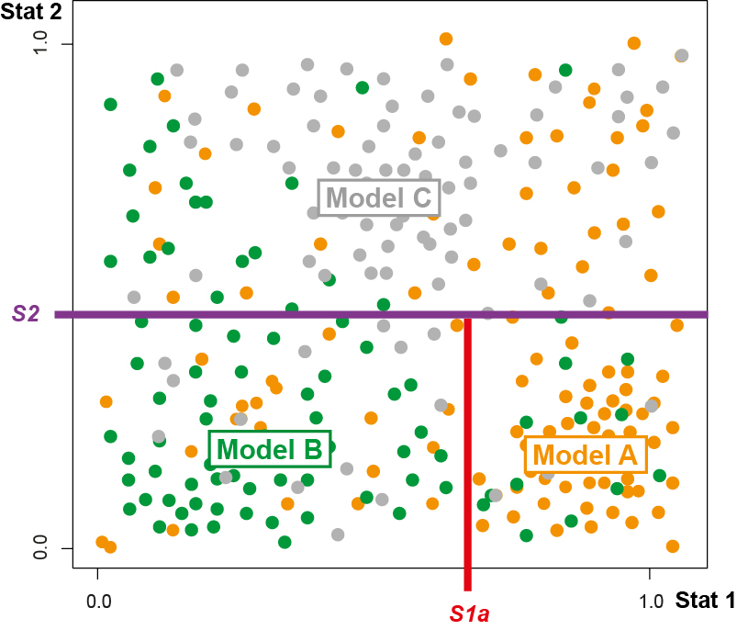
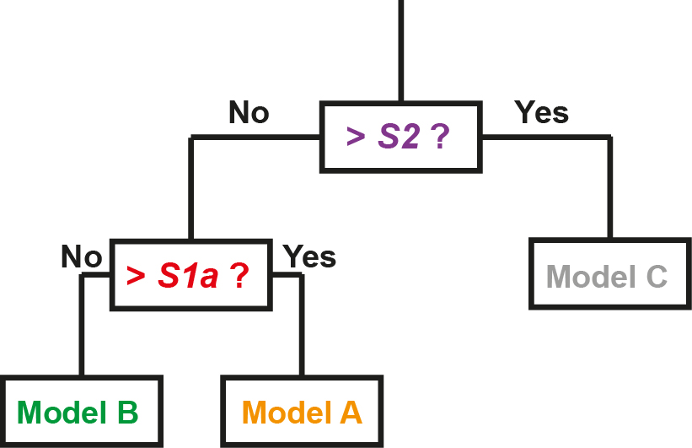
Random Forest algorithm for model choice (Breiman 2001)
Draw randomly Stats order
Build Decision Tree 1
Draw randomly Stats order
Build Decision Tree 2

Slide 66
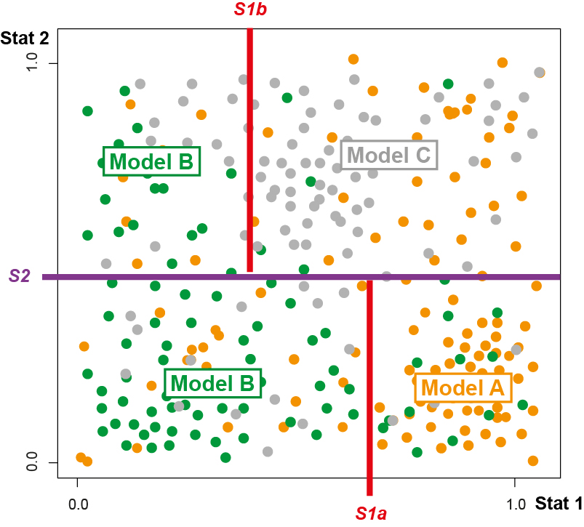
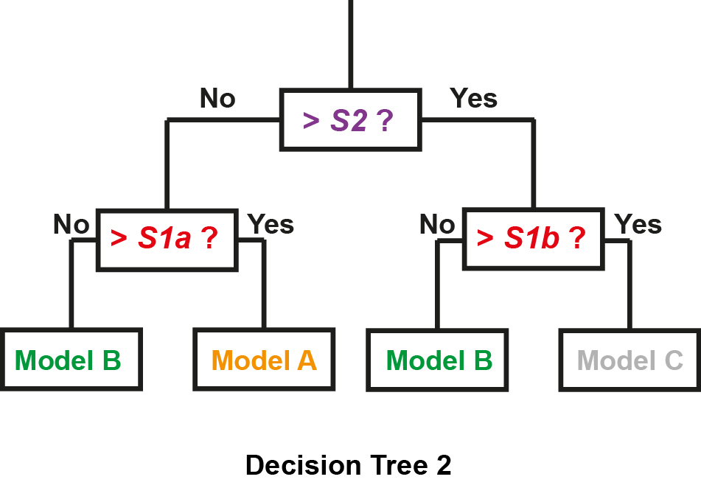
Random Forest algorithm for model choice (Breiman 2001)
Draw randomly Stats order
Build Decision Tree 1
Draw randomly Stats order
Build Decision Tree 2

Slide 67
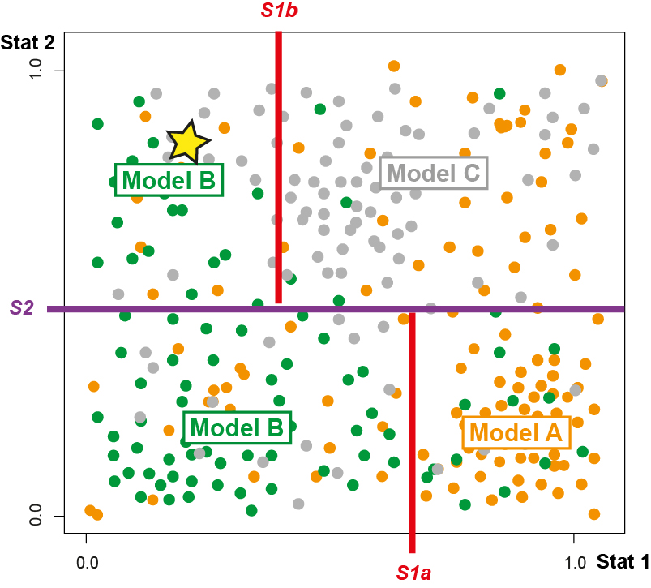
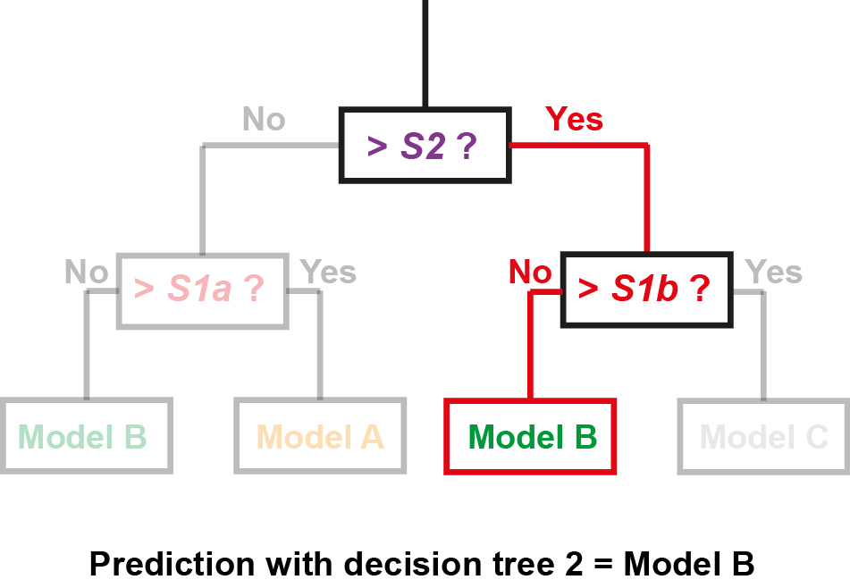
Random Forest algorithm for model choice (Breiman 2001)
Draw randomly Stats order
Build Decision Tree 1
Draw randomly Stats order
Build Decision Tree 2

Slide 68
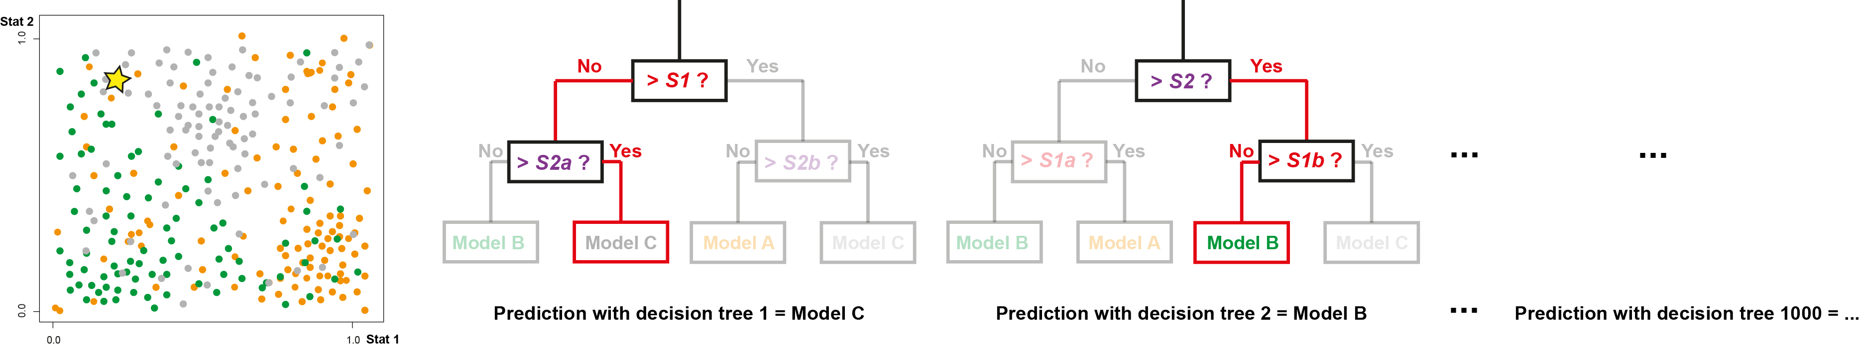
Random Forest algorithm for model choice (Breiman 2001)
Draw randomly Stats order
Build Decision Tree 1
Draw randomly Stats order
Build Decision Tree 2
Prediction for the observed data is, e.g., the majority of votes across 1000 trees in the random forest

Slide 69


Results: MetHis-ABC model-choice with Random-Forest a priori without observed data
Random Forest ABC (abcrf package in R, Pudlo et al. 2016) – 10,000 MetHis sims/scenario – 1,000 trees
Cross-validation all simulations
100,000 independent SNPs
Sample sizes:
Afr Source : 90 indivs
Eur Source : 89 indivs
Admixed population H : 50 indivs
Prior error rate = 32.41%, Model-choice error a priori = 8/9 = 88.89%
Fortes-Lima et al., Mol Ecol Res 2021

Slide 70
Results: MetHis-ABC model-choice with Random-Forest a priori without observed data
Random Forest ABC (abcrf package in R, Pudlo et al. 2016) – 10,000 MetHis sims/scenario – 1,000 trees
Cross-validation all simulations
100,000 independent SNPs
Sample sizes:
Afr Source : 90 indivs
Eur Source : 89 indivs
Admixed population H : 50 indivs
Prior error rate = 32.41%, Model-choice error a priori = 8/9 = 88.89%
Fortes-Lima et al., Mol Ecol Res 2021

Slide 71
Results: MetHis-ABC model-choice with Random-Forest a priori without observed data
Random Forest ABC (abcrf package in R, Pudlo et al. 2016) – 10,000 MetHis sims/scenario – 1,000 trees
Cross-validation all simulations
100,000 independent SNPs
Sample sizes:
Afr Source : 90 indivs
Eur Source : 89 indivs
Admixed population H : 50 indivs
Prior error rate = 32.41%, Model-choice error a priori = 8/9 = 88.89%
Fortes-Lima et al., Mol Ecol Res 2021

Slide 72
Results: MetHis-ABC model-choice with Random-Forest a priori without observed data
Random Forest ABC (abcrf package in R, Pudlo et al. 2016) – 10,000 MetHis sims/scenario – 1,000 trees
Cross-validation all simulations
100,000 independent SNPs
Sample sizes:
Afr Source : 90 indivs
Eur Source : 89 indivs
Admixed population H : 50 indivs
Model – Nestedness (Robert et al. 2011)
• Erroneous model-choice increased among scenarios qualitatively similar
Prior error rate = 32.41%, Model-choice error a priori = 8/9 = 88.89%
Fortes-Lima et al., Mol Ecol Res 2021

Slide 73

Results: MetHis-ABC model-choice with Random-Forest a priori without observed data
Random Forest ABC (abcrf package in R, Pudlo et al. 2016) – 10,000 MetHis sims/scenario – 1,000 decision trees in the random forest
Cross-validation 1000 simulations as pseudo-observed data under the AfrDE-EurDE model
Fortes-Lima et al., Mol Ecol Res 2021

Slide 74

Results: MetHis-ABC model-choice with Random-Forest a priori without observed data
Random Forest ABC (abcrf package in R, Pudlo et al. 2016) – 10,000 MetHis sims/scenario – 1,000 decision trees in the random forest
Cross-validation 1000 simulations as pseudo-observed data under the AfrDE-EurDE model
Fortes-Lima et al., Mol Ecol Res 2021

Slide 75

Results: MetHis-ABC model-choice with Random-Forest a priori without observed data
Random Forest ABC (abcrf package in R, Pudlo et al. 2016) – 10,000 MetHis sims/scenario – 1,000 decision trees in the random forest
Cross-validation 1000 simulations as pseudo-observed data under the AfrDE-EurDE model
Fortes-Lima et al., Mol Ecol Res 2021

Slide 76

Results: MetHis-ABC model-choice with Random-Forest a priori without observed data
Random Forest ABC (abcrf package in R, Pudlo et al. 2016) – 10,000 MetHis sims/scenario – 1,000 decision trees in the random forest
Cross-validation 1000 simulations as pseudo-observed data under the AfrDE-EurDE model
Fortes-Lima et al., Mol Ecol Res 2021

Slide 77

Results: MetHis-ABC model-choice with Random-Forest a priori without observed data
Random Forest ABC (abcrf package in R, Pudlo et al. 2016) – 10,000 MetHis sims/scenario – 1,000 decision trees in the random forest
Cross-validation 1000 simulations as pseudo-observed data under the AfrDE-EurDE model
Fortes-Lima et al., Mol Ecol Res 2021

Slide 78

Results: MetHis-ABC model-choice with Random-Forest a priori without observed data
Random Forest ABC (abcrf package in R, Pudlo et al. 2016) – 10,000 MetHis sims/scenario – 1,000 decision trees in the random forest
Cross-validation 1000 simulations as pseudo-observed data under the AfrDE-EurDE model
Model – Nestedness (Robert et al. 2011)
• Erroneous model-choice increases in the space of parameters where scenarios are highly nested and thus biologically similar
Fortes-Lima et al., Mol Ecol Res 2021

Slide 79

Results: MetHis-ABC model-choice with Random-Forest a priori without observed data
Random Forest ABC (abcrf package in R, Pudlo et al. 2016) – 10,000 MetHis sims/scenario – 1,000 decision trees in the random forest
Cross-validation all simulations
100,000 independent SNPs
Sample sizes:
Afr Source : 90 indivs
Eur Source : 89 indivs
Admixed population H : 50 indivs
Prior error rate = 32.41%
Model-choice error a priori = 8/9 = 88.89%
Fortes-Lima et al., Mol Ecol Res 2021

Slide 80

Results: MetHis-ABC model-choice with Random-Forest a priori without observed data
Random Forest ABC (abcrf package in R, Pudlo et al. 2016) – 10,000 MetHis sims/scenario – 1,000 decision trees in the random forest
Cross-validation all simulations
100,000 independent SNPs
Sample sizes:
Afr Source : 90 indivs
Eur Source : 89 indivs
Admixed population H : 50 indivs
50,000 independent SNPs
Sample sizes:
Afr Source : 90 indivs
Eur Source : 89 indivs
Admixed population H : 50 indivs
Prior error rate = 32.41%
Model-choice error a priori = 8/9 = 88.89%
Prior error rate = 33.53%
Model-choice error a priori = 8/9 = 88.89%
Fortes-Lima et al., Mol Ecol Res 2021

Slide 81

Results: MetHis-ABC model-choice with Random-Forest a priori without observed data
Random Forest ABC (abcrf package in R, Pudlo et al. 2016) – 10,000 MetHis sims/scenario – 1,000 decision trees in the random forest
Cross-validation all simulations
100,000 independent SNPs
Sample sizes:
Afr Source : 90 indivs
Eur Source : 89 indivs
Admixed population H : 50 indivs
50,000 independent SNPs
Sample sizes:
Afr Source : 90 indivs
Eur Source : 89 indivs
Admixed population H : 50 indivs
10,000 independent SNPs
Sample sizes:
Afr Source : 90 indivs
Eur Source : 89 indivs
Admixed population H : 50 indivs
Prior error rate = 32.41%
Model-choice error a priori = 8/9 = 88.89%
Prior error rate = 33.53%
Model-choice error a priori = 8/9 = 88.89%
Prior error rate = 37.93%
Model-choice error a priori = 8/9 = 88.89%
Fortes-Lima et al., Mol Ecol Res 2021

Slide 82

Results: MetHis-ABC model-choice with Random-Forest a priori without observed data
Random Forest ABC (abcrf package in R, Pudlo et al. 2016) – 10,000 MetHis sims/scenario – 1,000 decision trees in the random forest
Cross-validation all simulations
100,000 independent SNPs
Sample sizes:
Afr Source : 90 indivs
Eur Source : 89 indivs
Admixed population H : 50 indivs
100,000 independent SNPs
Sample sizes:
Afr Source : 18 indivs
Eur Source : 18 indivs
Admixed population H : 10 indivs
Prior error rate = 32.41%
Model-choice error a priori = 8/9 = 88.89%
Prior error rate = 48.39%
Model-choice error a priori = 8/9 = 88.89%
ABC relies on summary-statistics informativeness rather than absolute amount of data
Fortes-Lima et al., Mol Ecol Res 2021

Slide 83

Results: MetHis-ABC model-choice with Random-Forest a priori without observed data
Random Forest ABC (abcrf package in R, Pudlo et al. 2016) – 10,000 MetHis sims/scenario – 1,000 decision trees in the random forest
Cross-validation all simulations
100,000 independent SNPs
Sample sizes:
Afr Source : 90 indivs
Eur Source : 89 indivs
Admixed population H : 50 indivs
Prior error rate = 32.41%
Model-choice error a priori = 8/9 = 88.89%
Fortes-Lima et al., Mol Ecol Res 2021

Slide 84

Results: MetHis-ABC model-choice with Random-Forest a priori without observed data
MetHis-ABC Random-Forest model-choice a priori powerful to distinguish highly complex historical admixture models
Fortes-Lima et al., Mol Ecol Res 2021

Slide 85
Results: MetHis-ABC model-choice with Random-Forest a priori without observed data
MetHis-ABC Random-Forest model-choice a priori powerful to distinguish highly complex historical admixture models
Errors are made in the parameter-space where models are highly nested and thus biologically similar
Fortes-Lima et al., Mol Ecol Res 2021

Slide 86
Results: MetHis-ABC model-choice with Random-Forest a priori without observed data
MetHis-ABC Random-Forest model-choice a priori powerful to distinguish highly complex historical admixture models
Errors are made in the parameter-space where models are highly nested and thus biologically similar
MetHis-ABC Random-Forest model-choice performances are robust to reduced SNP and Sample sets
Fortes-Lima et al., Mol Ecol Res 2021

Slide 87
Results: MetHis-ABC model-choice with Random-Forest a priori without observed data
MetHis-ABC Random-Forest model-choice a priori powerful to distinguish highly complex historical admixture models
Errors are made in the parameter-space where models are highly nested and thus biologically similar
MetHis-ABC Random-Forest model-choice performances are robust to reduced SNP and Sample sets
-> ABC relies on summary-statistics informativeness rather than absolute amount of data
Fortes-Lima et al., Mol Ecol Res 2021

Slide 88
Results: MetHis-ABC model-choice with Random-Forest a priori without observed data
MetHis-ABC Random-Forest model-choice a priori powerful to distinguish highly complex historical admixture models
Errors are made in the parameter-space where models are highly nested and thus biologically similar
MetHis-ABC Random-Forest model-choice performances are robust to reduced SNP and Sample sets
-> ABC relies on summary-statistics informativeness rather than absolute amount of data
Distribution of admixture fractions is highly informative for admixture history inference
Fortes-Lima et al., Mol Ecol Res 2021

Slide 89
Results: MetHis-ABC complex admixture history of ACB and ASW populations
9 competing scenarios
10,000 MetHis sims/scenario
100,000 independent SNPs
24 summary-statistics
Simulating observed data with MetHis ?
Fortes-Lima et al., Mol Ecol Res 2021

Slide 90

Results: MetHis-ABC complex admixture history of ACB and ASW populations
9 competing scenarios
10,000 MetHis sims/scenario
100,000 independent SNPs
24 summary-statistics
Simulating observed data with MetHis ?
Fortes-Lima et al., Mol Ecol Res 2021

Slide 91

Results: MetHis-ABC complex admixture history of ACB and ASW populations
9 competing scenarios
10,000 MetHis sims/scenario
100,000 independent SNPs
24 summary-statistics
Simulating observed data with MetHis ?
Simulating admixed populations with MetHis provides summary statistics very reasonably fitting the observed data for ACB and ASW
Fortes-Lima et al., Mol Ecol Res 2021

Slide 92
Results: MetHis-ABC complex admixture history of ACB and ASW populations
Model-choice
Random Forest ABC
abcrf package in R (Pudlo et al. 2016)
1,000 decision trees in the forest
9 competing scenarios
10,000 MetHis sims/scenario
100,000 independent SNPs
24 summary-statistics
Fortes-Lima et al., Mol Ecol Res 2021

Slide 93


Results: MetHis-ABC complex admixture history of ACB and ASW populations
Model-choice
Random Forest ABC
abcrf package in R (Pudlo et al. 2016)
1,000 decision trees in the forest
9 competing scenarios
10,000 MetHis sims/scenario
100,000 independent SNPs
24 summary-statistics
Fortes-Lima et al., Mol Ecol Res 2021

Slide 94


Results: MetHis-ABC complex admixture history of ACB and ASW populations
Model-choice
Random Forest ABC
abcrf package in R (Pudlo et al. 2016)
1,000 decision trees in the forest
9 competing scenarios
10,000 MetHis sims/scenario
100,000 independent SNPs
24 summary-statistics
Fortes-Lima et al., Mol Ecol Res 2021

Slide 95

Results: MetHis-ABC complex admixture history of ACB and ASW populations
Parameter-inference
Neural Network ABC
abc package in R (Csilléry et al. 2012)
Tolerance 1% (1,000 sims closest to obs.)
4 neurons in the hidden layer
1 best scenario
100,000 MetHis sims
100,000 independent SNPs
24 summary-statistics
Fortes-Lima et al., Mol Ecol Res 2021

Slide 96

Results: MetHis-ABC complex admixture history of ACB and ASW populations
Parameter-inference
Neural Network ABC
abc package in R (Csilléry et al. 2012)
Tolerance 1% (1,000 sims closest to obs.)
4 neurons in the hidden layer
1 best scenario
100,000 MetHis sims
100,000 independent SNPs
24 summary-statistics
Fortes-Lima et al., Mol Ecol Res 2021

Slide 97
Results: MetHis-ABC complex admixture history of ACB and ASW populations
Parameter-inference
Neural Network ABC
abc package in R (Csilléry et al. 2012)
Tolerance 1% (1,000 sims closest to obs.)
4 neurons in the hidden layer
1,000 cross-validation NN min av. posterior errors
1 best scenario
100,000 MetHis sims
100,000 independent SNPs
24 summary-statistics
Cross-validation post param error
1,000 closest simulations in turn used as controlled pseudo-observed data for NN-ABC param inference
Fortes-Lima et al., Mol Ecol Res 2021

Slide 98
Results: MetHis-ABC complex admixture history of ACB and ASW populations
Parameter-inference
Neural Network ABC
abc package in R (Csilléry et al. 2012)
Tolerance 1% (1,000 sims closest to obs.)
4 neurons in the hidden layer
1,000 cross-validation NN min av. posterior errors
1 best scenario
100,000 MetHis sims
100,000 independent SNPs
24 summary-statistics
Cross-validation 95% CI accuracy
1,000 closest simulations in turn used as controlled pseudo-observed data for NN-ABC param inference
Fortes-Lima et al., Mol Ecol Res 2021

Slide 99

Results: MetHis-ABC complex admixture history of ACB and ASW populations
Rapid diminishing of European admixture
Less European admixture in ACB than in ASW
Strong continuing African admixture:
- post-slavery migrations
- assortative matting ?
Fortes-Lima et al., Mol Ecol Res 2021

Slide 100

Conclusions
MetHis – RF-ABC is successful in distinguishing a priori among competing highly complex admixture models
Admixture distribution is highly informative for ABC model choice as expected theoretically
MetHis – NN-ABC produces accurate posterior parameter estimation and relatively conservative 95% CI inference
Fortes-Lima et al., Mol Ecol Res 2021

Slide 101

Conclusions
*
*
Special issue Machine Learning in Molecular Ecology
https://github.com/romain-laurent/MetHis
Fortes-Lima et al., Mol Ecol Res 2021

Slide 102






Ongoing !
Reconstructing the admixture history of Cape Verde
with Romain Laurent (UMR7206), Noah Rosenberg (Stanford University) and Marlyse Baptista (University of Michigan)
©Paul Verdu, Cape Verde 2010-2018
©Paul Verdu, Cape Verde 2010-2018
©Paul Verdu, Cape Verde 2010-2018
©Paul Verdu, Cape Verde 2010-2018
©Paul Verdu, Cape Verde 2010-2018

Slide 103


Ongoing !
Reconstructing the admixture history of Cape Verde
with Romain Laurent (UMR7206)
Noah Rosenberg (Stanford University)
and Marlyse Baptista (University of Michigan)

Slide 104

Ongoing !
Reconstructing the admixture history of Cape Verde
with Romain Laurent (UMR7206), Noah Rosenberg (Stanford University) and Marlyse Baptista (University of Michigan)

Slide 105

Ongoing !
Reconstructing the admixture history of Cape Verde
with Romain Laurent (UMR7206), Noah Rosenberg (Stanford University) and Marlyse Baptista (University of Michigan)

Slide 106

Ongoing !
Reconstructing the admixture history of Cape Verde
with Romain Laurent (UMR7206)
Noah Rosenberg (Stanford University)
and Marlyse Baptista (University of Michigan)

Slide 107

Ongoing !
Microsatellites and Terminalia superba hybridization zone in the « Dahomey Gap » (West Africa)
With Romain Laurent (UMR7206) and Olivier Hardy (Univ. Bruxelles)

Slide 108


Ongoing !
Deterministic usage of MetHis for exploring admixture history influence on summary-statistics
with Maël Pretet (Master 2 student) and Romain Laurent (UMR7206)

Slide 109
Ongoing !
Future developments of MetHis:
- Additional statistics (admixture LD, ROH…)
- Sequences simulations (and mutation…)
- M source populations (Verdu and Rosenberg 2011)
- sex-specific models and X, Y and mtDNA data and statistics
Marta Ciccarella, PhD student
dir. Paul Verdu and Jorge Rocha (Univ Porto)
-> Selection ?
Already in part feasible by parametrizing Ne changes accordingly

Slide 110
Great Many Thanks !
Acknowledgements
Frédéric Austerlitz
Erkan O. Buzbas
Antoine Cools
Flora Jay
Olivier Hardy
Evelyne Heyer
Margueritte Lapierre
Guillaume Laval
Nina Marchi
Etienne Patin
Maël Pretet
Noah A. Rosenberg
Zachary A. Szpiech
Co-authors !
Cesar Fortes-Lima (Uppsala University)
Romain Laurent (UMR7206)
Valentin Thouzeau (Univ. Paris-Dauphine)
Bruno Toupance (UMR7206)
Funding
ANR METHIS (15-CE32-0009-01)
Sven and Lilly Lawski's Foundation (N2019-0040)

Slide 111
MetHis – Simulations
MetHis simulates a panmictic admixed population of diploid size N_{g} at generation g, forward-in-time
MetHis does not simulate source populations, just the admixed population for the duration of the admixture process investigated
MetHis does not simulate mutation, yet…
Afro-American and Barbadian study cases:
- We neglect mutation -> recent admixture process
- Large source populations (Yoruba and British):
20,000 gametes per source population
SNPs matching in frequencies observed 100,000 in each source
-> fixed source populations gamete reservoir
Build randomly source population parents anew at each generation
- Independent SNPs -> we randomly build gametes and randomly pair them (avoiding selfing) according to admixture parameters at each generation
- For simplicity, we set a constant Ne at each generation in the admixed population of 1,000 diploid individuals

Slide 112
ABC-part of the MetHis-ABC framework
R packages:
- abcrf (Pudlo et al. 2016; Raynal et al. 2017): Random-Forest ABC
- abc (Csilléry et al. 2012): Neural-Network and Rejection ABC
Model Choice:
Random-Forest ABC with 10,000 simulations per scenario
Parameter estimation:
Neural-Network with 100,000 simulations under the winning scenario
Parameter estimation error:
Neural-Network with 100,000 simulations under the winning scenario
1,000 closest simulations used in turn as pseudo-observed data
-> posterior parameter error
-> 95% Credibility Intervals accuracy

Slide 113

Results: MetHis simulations

